Slide 1
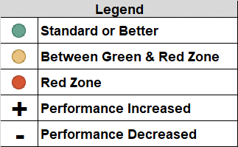
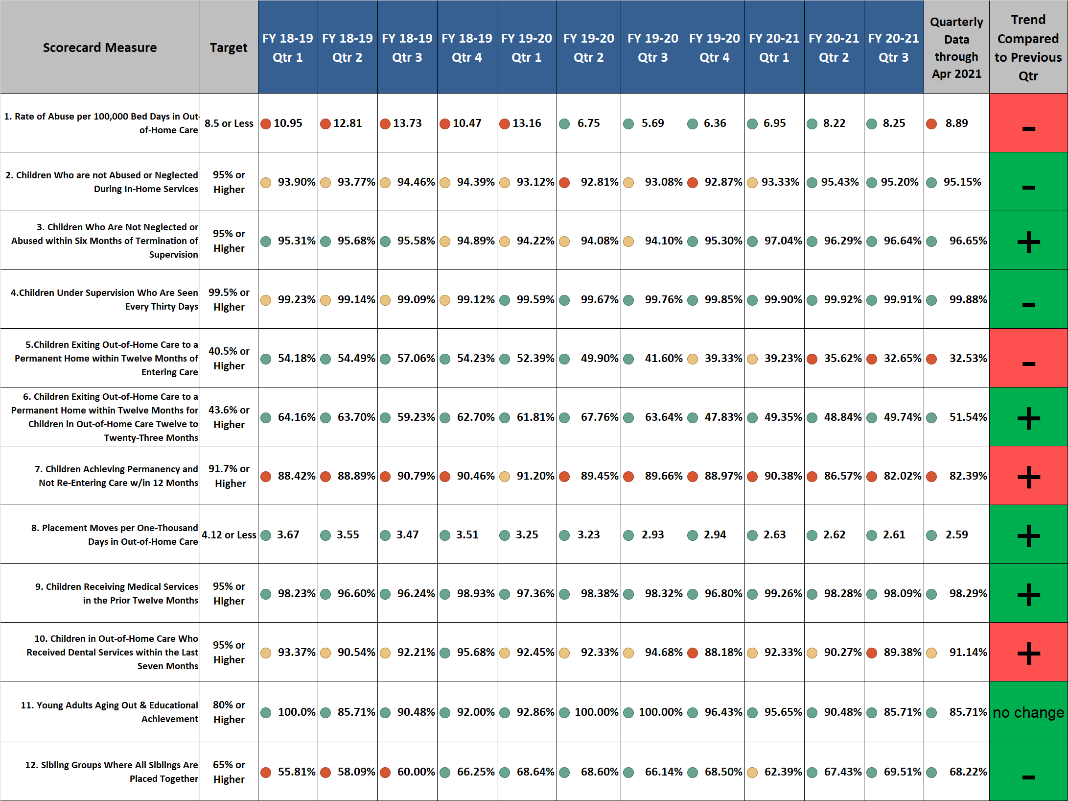
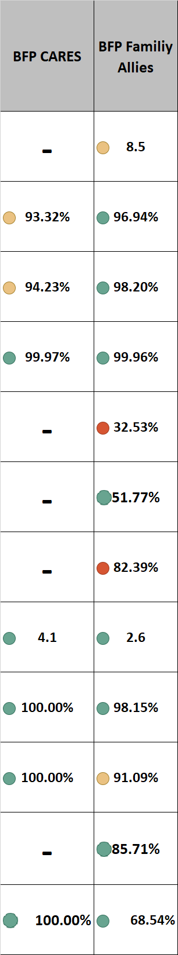
Brevard Family Partnership
Contract & Scorecard Measures Trends
for April 2021 (Unofficial Listing)

