Slide 1
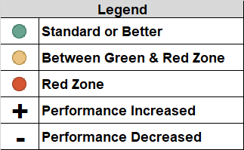
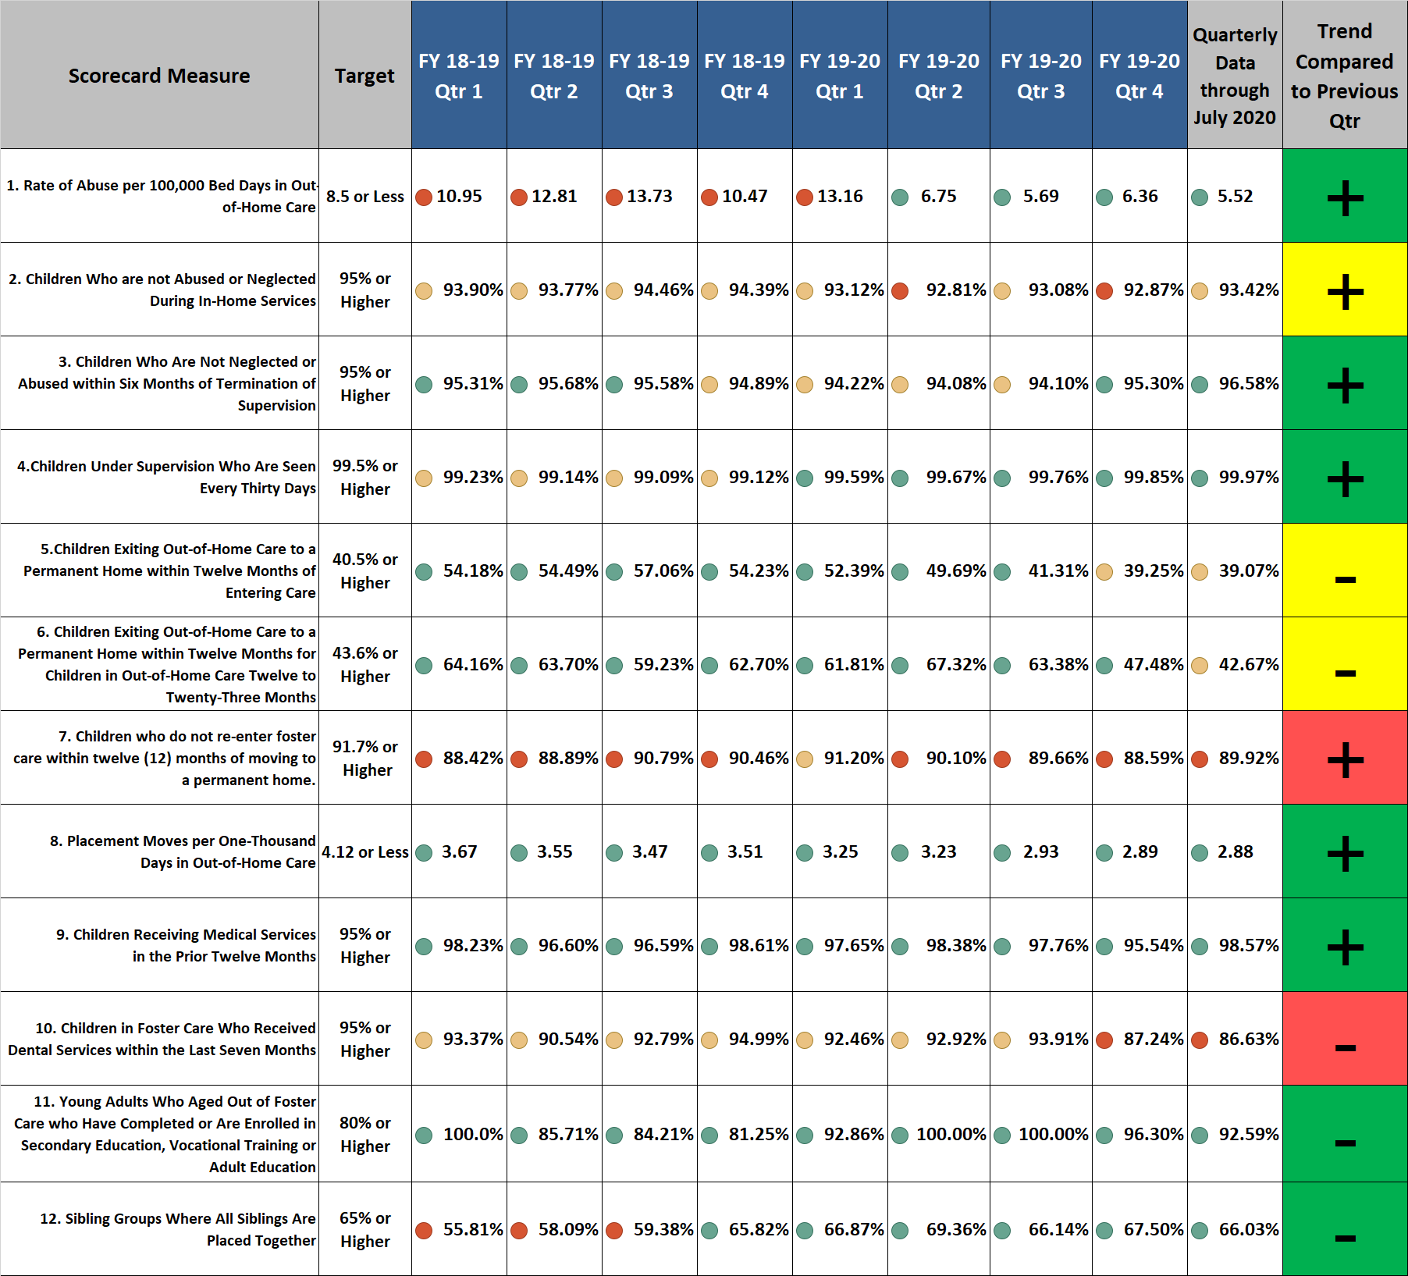
Brevard Family Partnership
Contract & Scorecard Measures Trends
for July 2020 (On Demand Listing)

