Slide 1

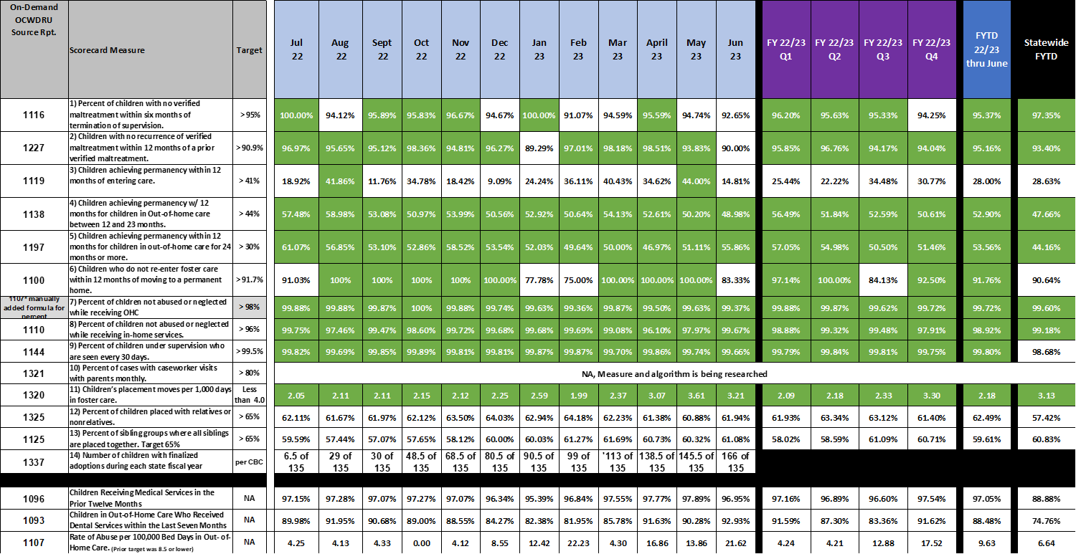
Brevard Family Partnership -- CBC Contract Measures – Fiscal Year to Date 22/23 through June 2023

