Slide 1
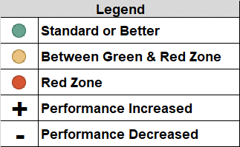
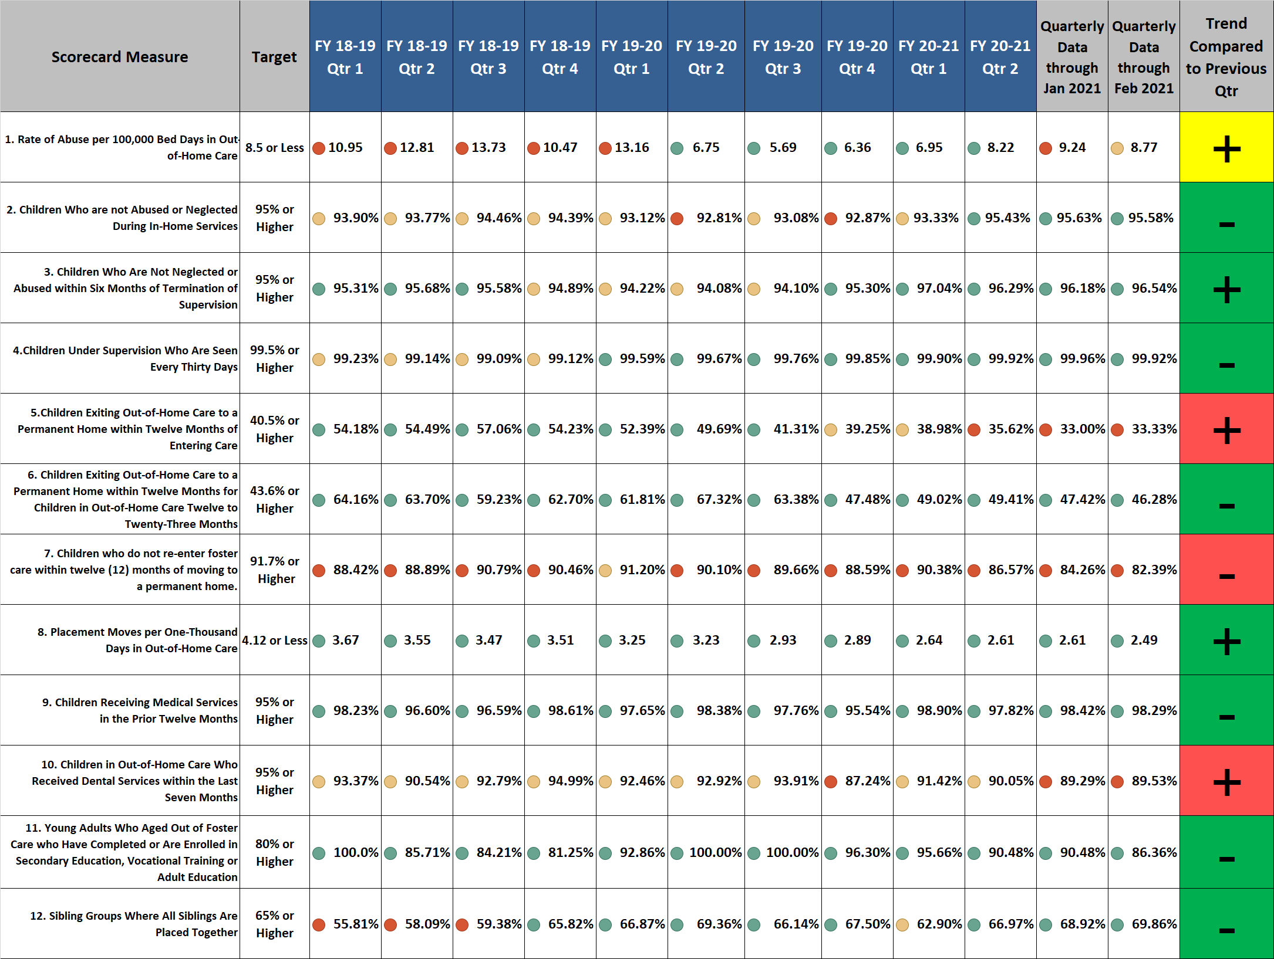
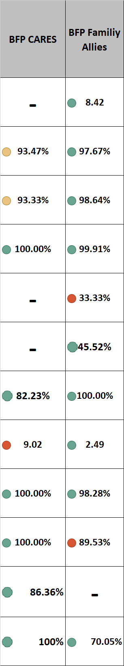
Brevard Family Partnership
Contract & Scorecard Measures Trends
for February 2021 (On Demand Listing)

