Slide 1



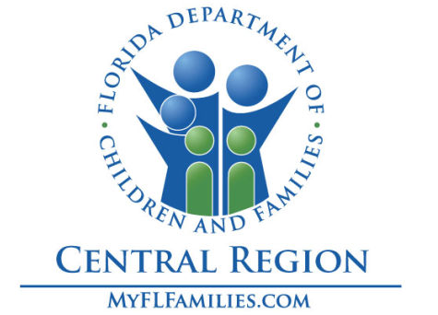
FL Department of Children & Families - Central Region
Community Base Care Monthly Trend Report
October 2024

Slide 2
CBC Monthly Trend Report
October 2024
Table of Contents
By Topic and Pages
Pages 3: CBC Contract Measures
Pages 4 - 7: Caseload Ratio and Caseload by Service Type
Pages 8 - 11: Trends of Children in Residential Group Care & Licensed OHC by Age Range
Pages 12 - 15: Removal and Discharge Monthly Trends
Page 16: Percent of Children Removed w/an Initial OHC Placement in Kinship Care
Page 17: Licensed Foster Homes and Beds
Page 18: Other Trends: Psychotropic Meds and Teens in a Family Setting
Page 19: Percent of In-Home Children with a Current Safety Plan
Page 20: Percent of Kinship Care Providers w/a Level 1 License or in Process
Page 26: Children in Licensed OHC placed out of County, Circuit or Region

Slide 3

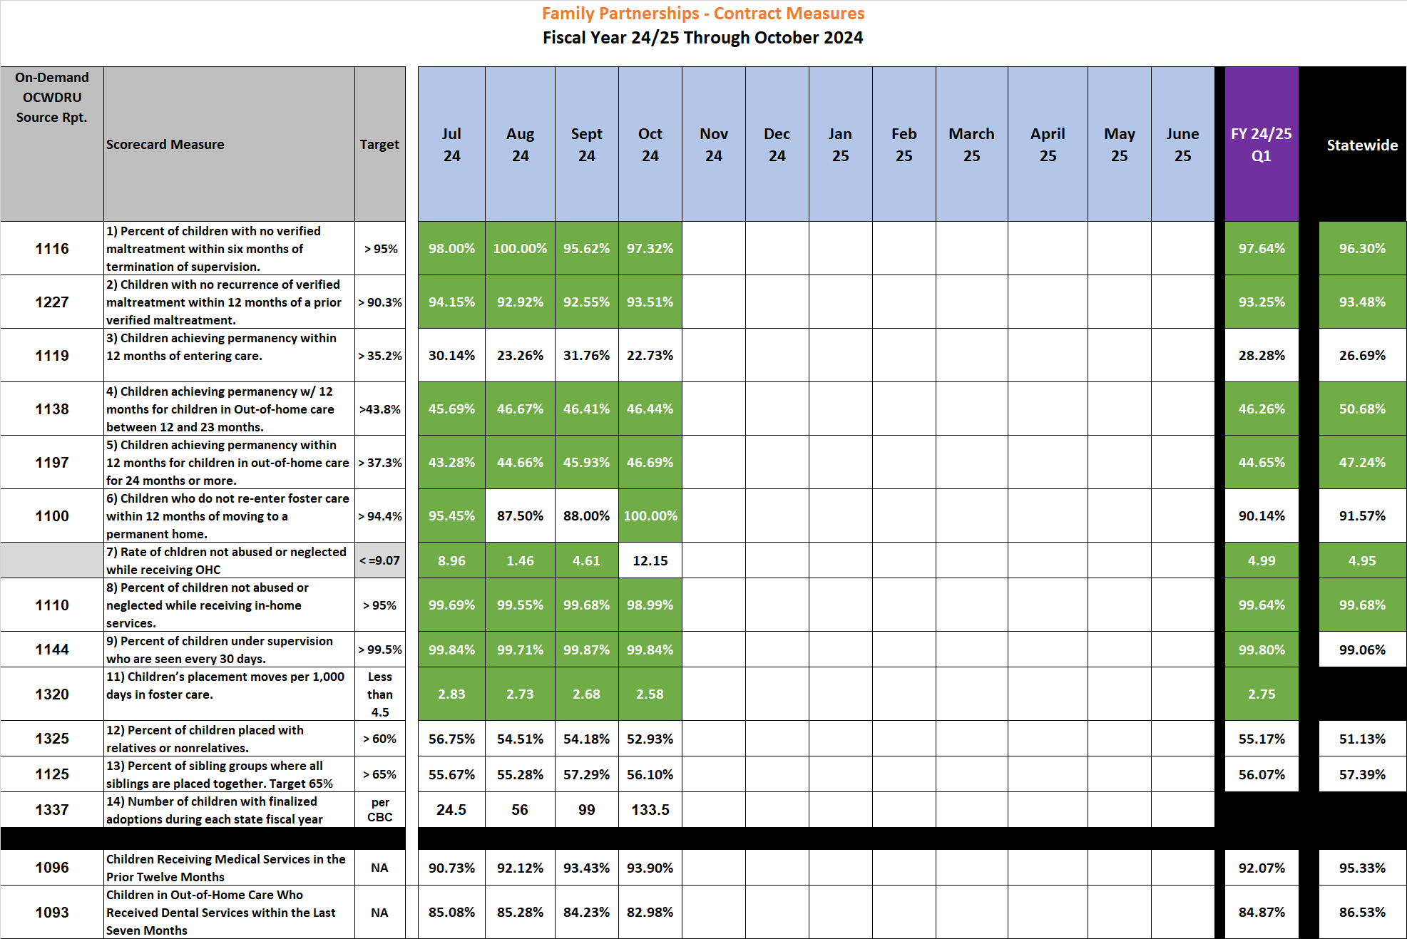
Family Partnerships of Central Florida-- CBC Contract Measures – Fiscal Year to Date 23/34 through October 2024

Slide 4
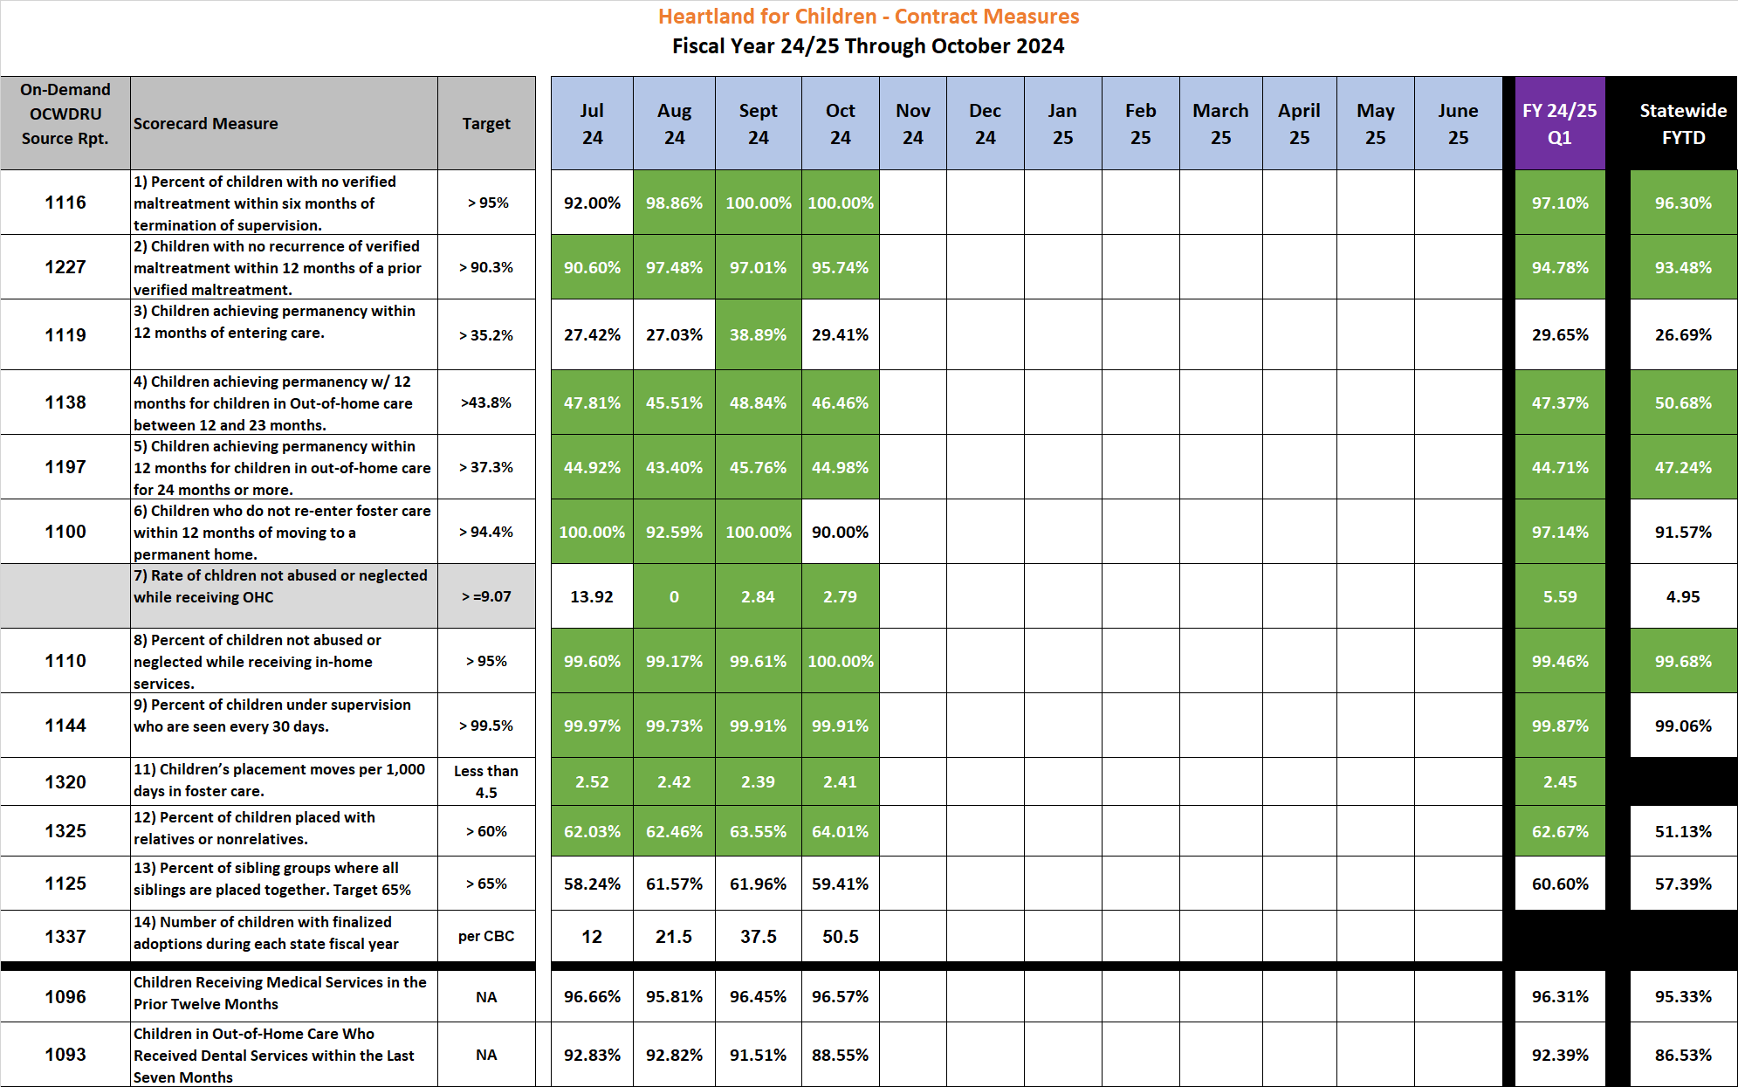
Heartland for Children -- CBC Contract Measures – Fiscal Year to Date 23/34 through October 2024

Slide 5
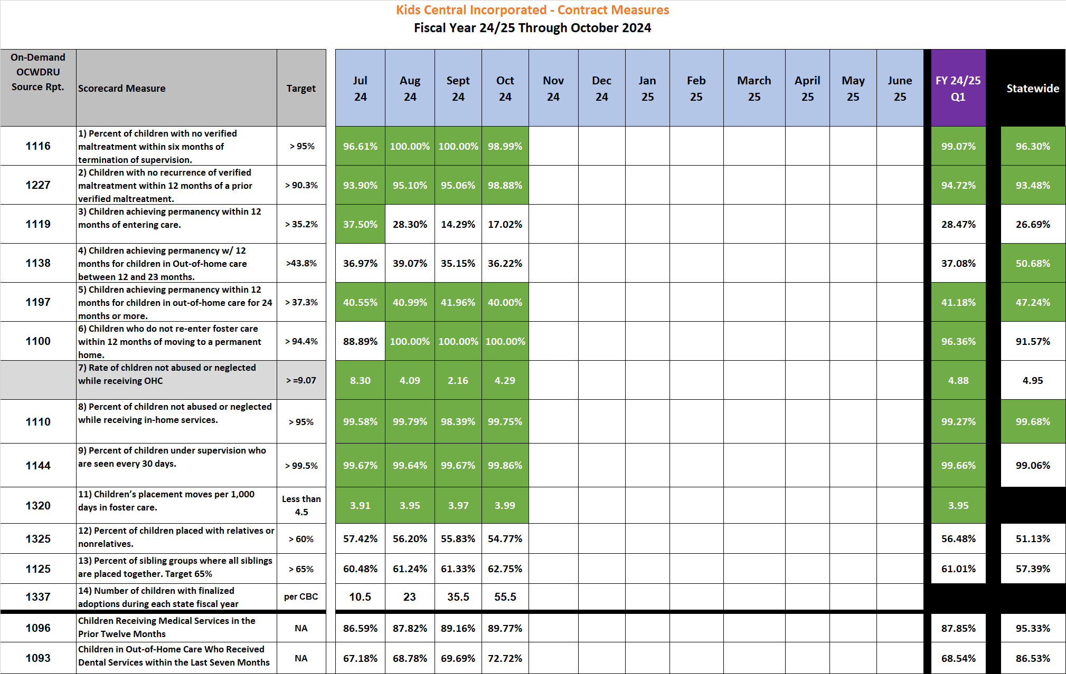
Kids Central Incorporated -- CBC Contract Measures – Fiscal Year to Date 23/24 through October 2024

Slide 6
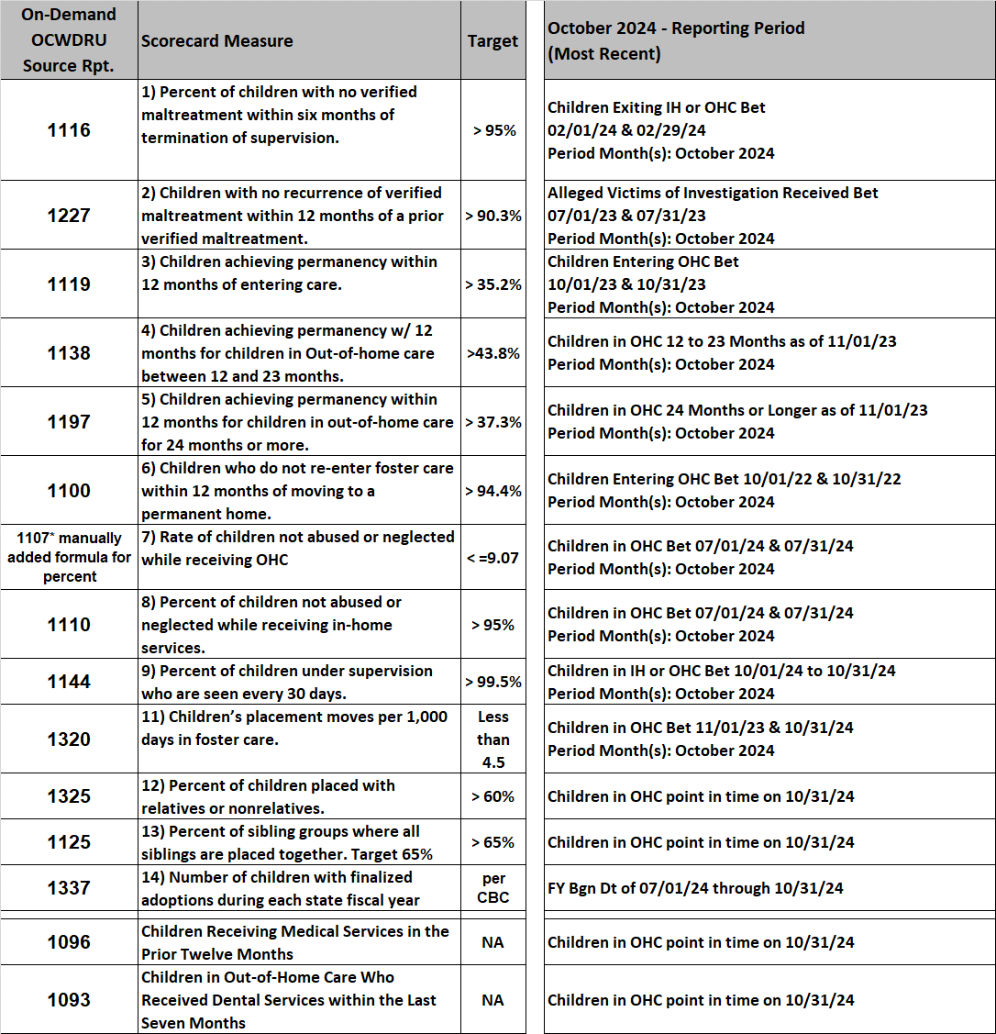
CBC Contract Measures – Fiscal Year to Date 23/24 through October 2024 Reporting Periods

Slide 7
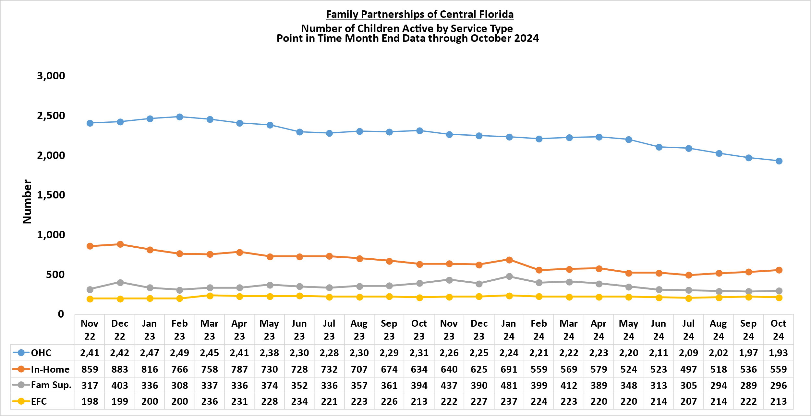
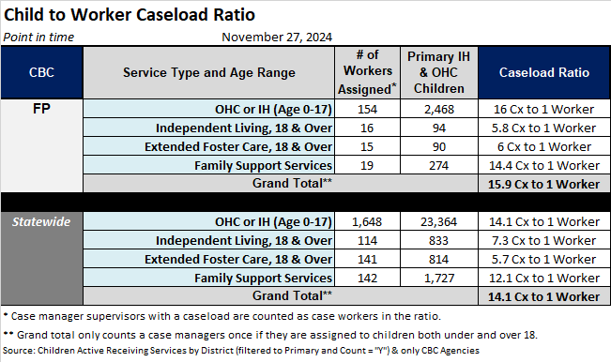
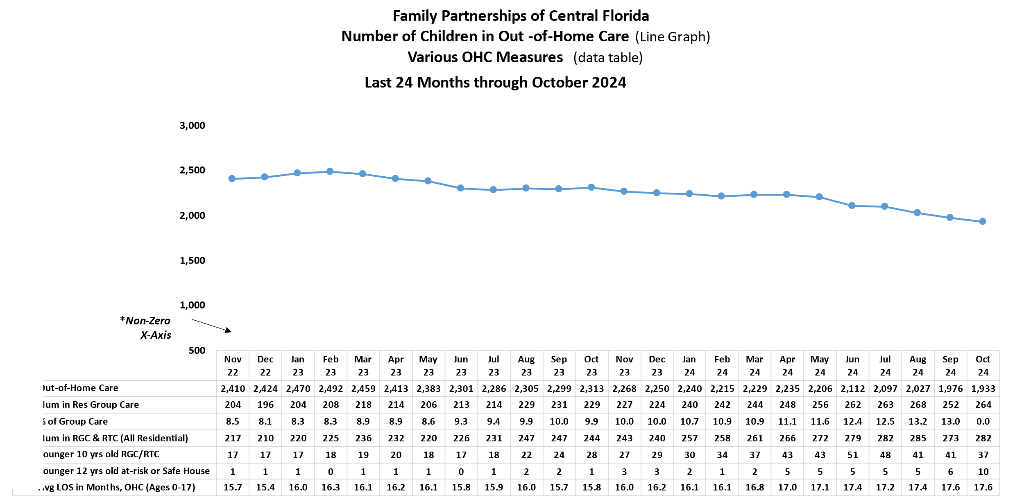
Child Caseloads – Family Partnerships of Central Florida
Number of Children by Type of Service
Child to Caseworker Ratio
Percent of OHC Caseloads by Type of Placement

Slide 8
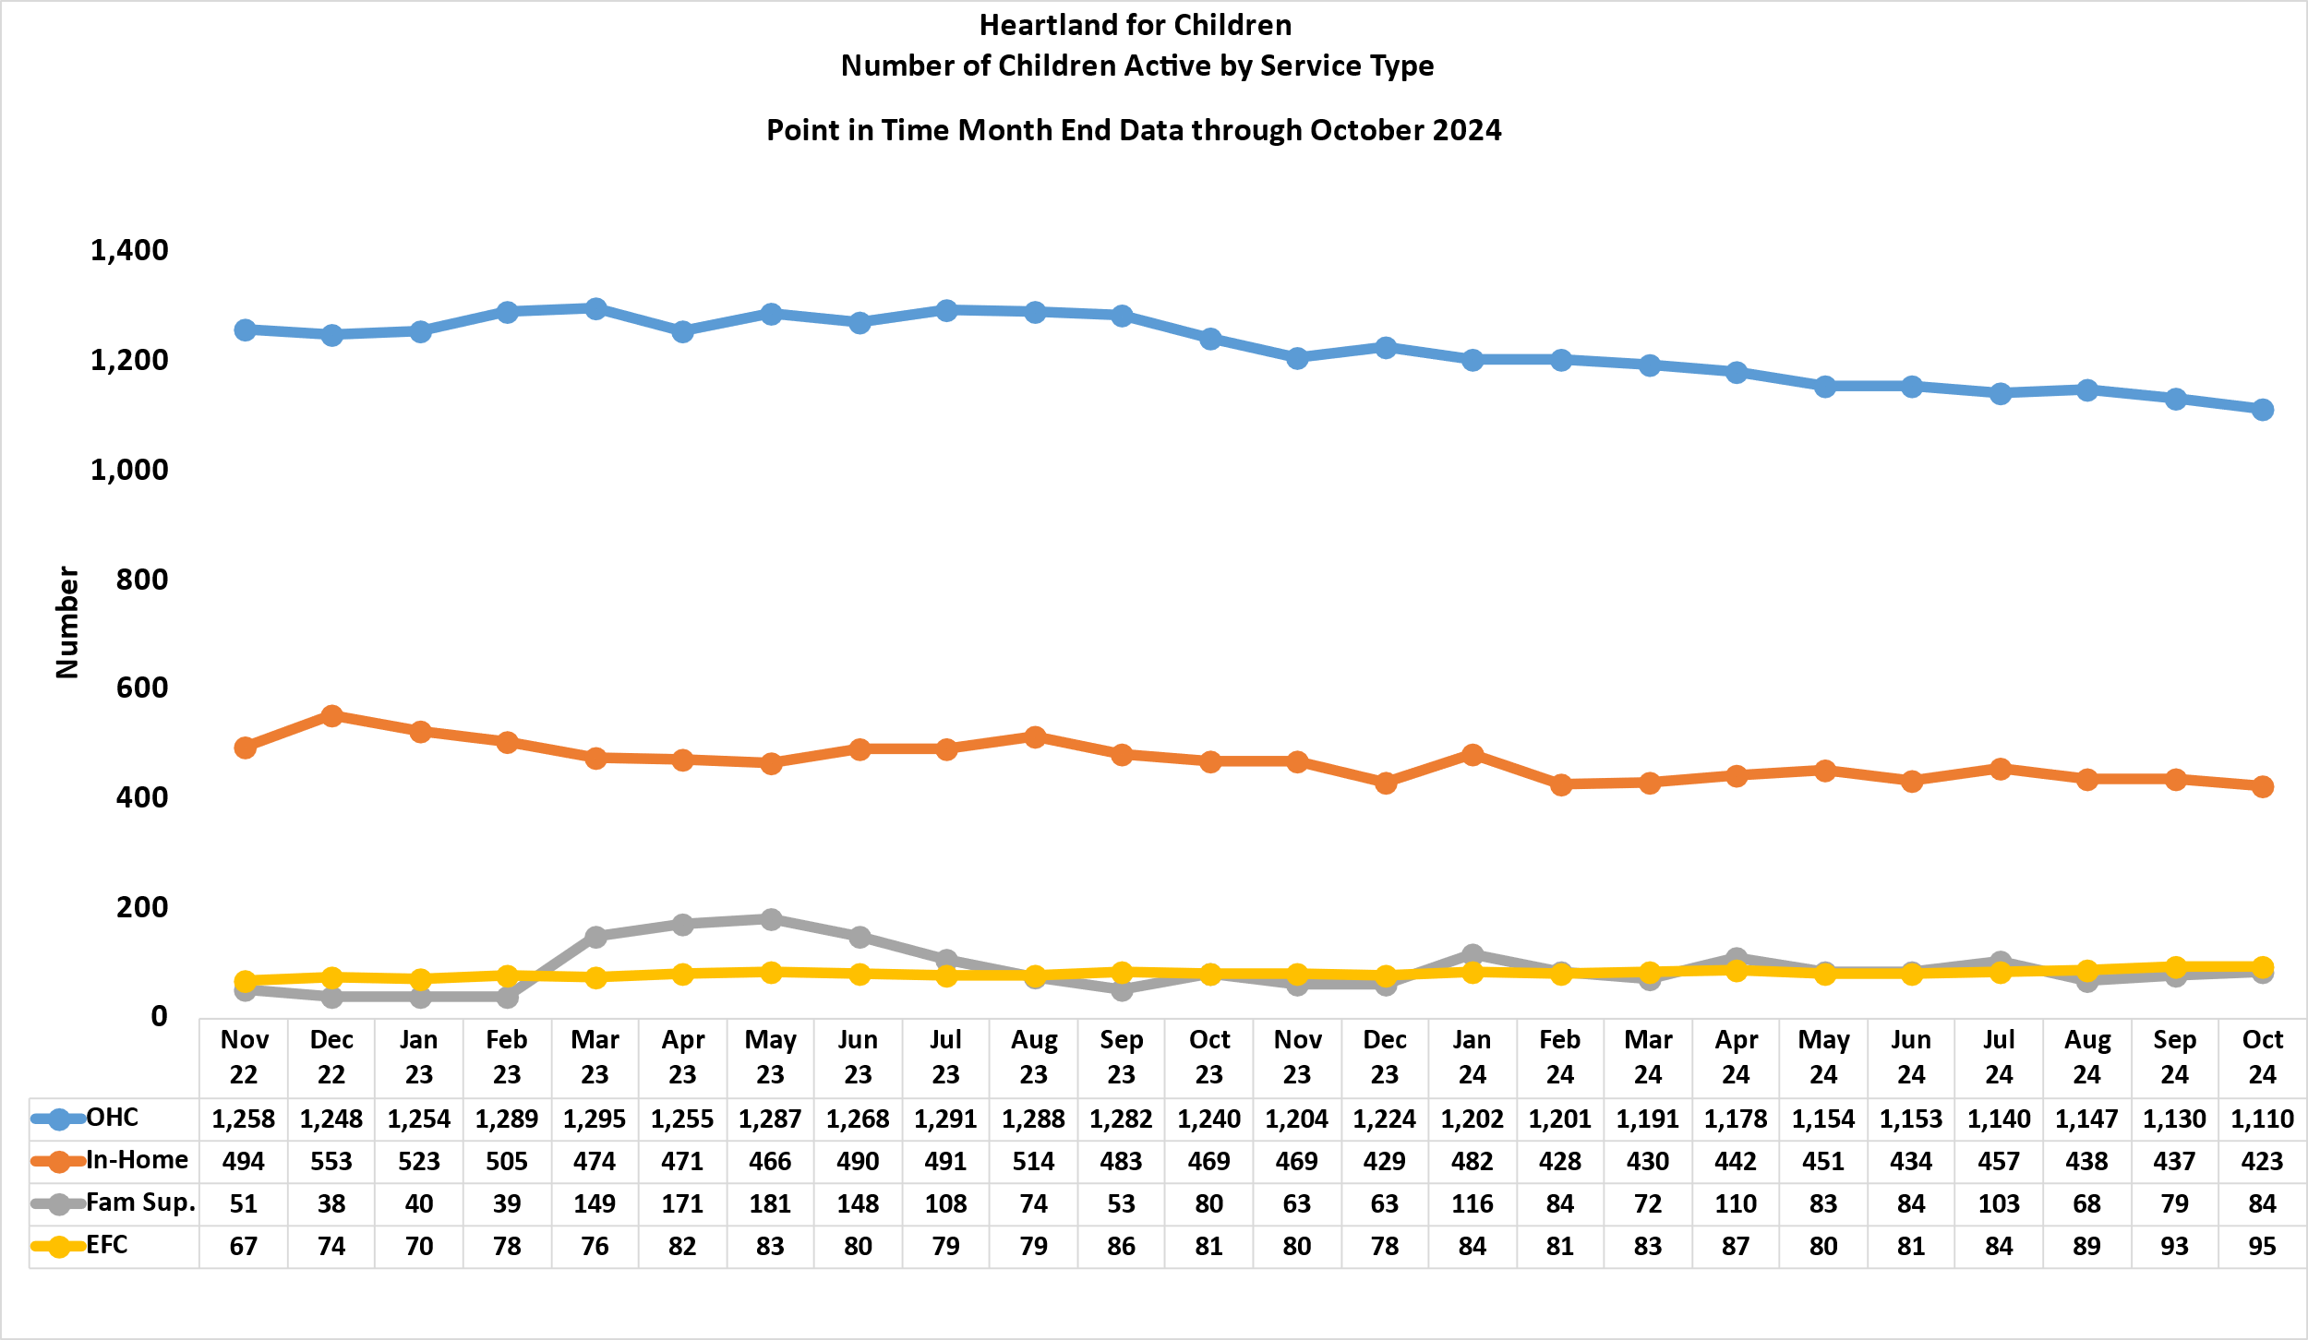

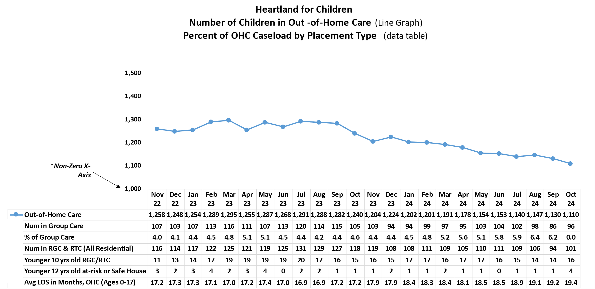
Child Caseloads – Heartland for Children
Number of Children by Type of Service
Child to Caseworker Ratio
Percent of OHC Caseloads by Type of Placement

Slide 9
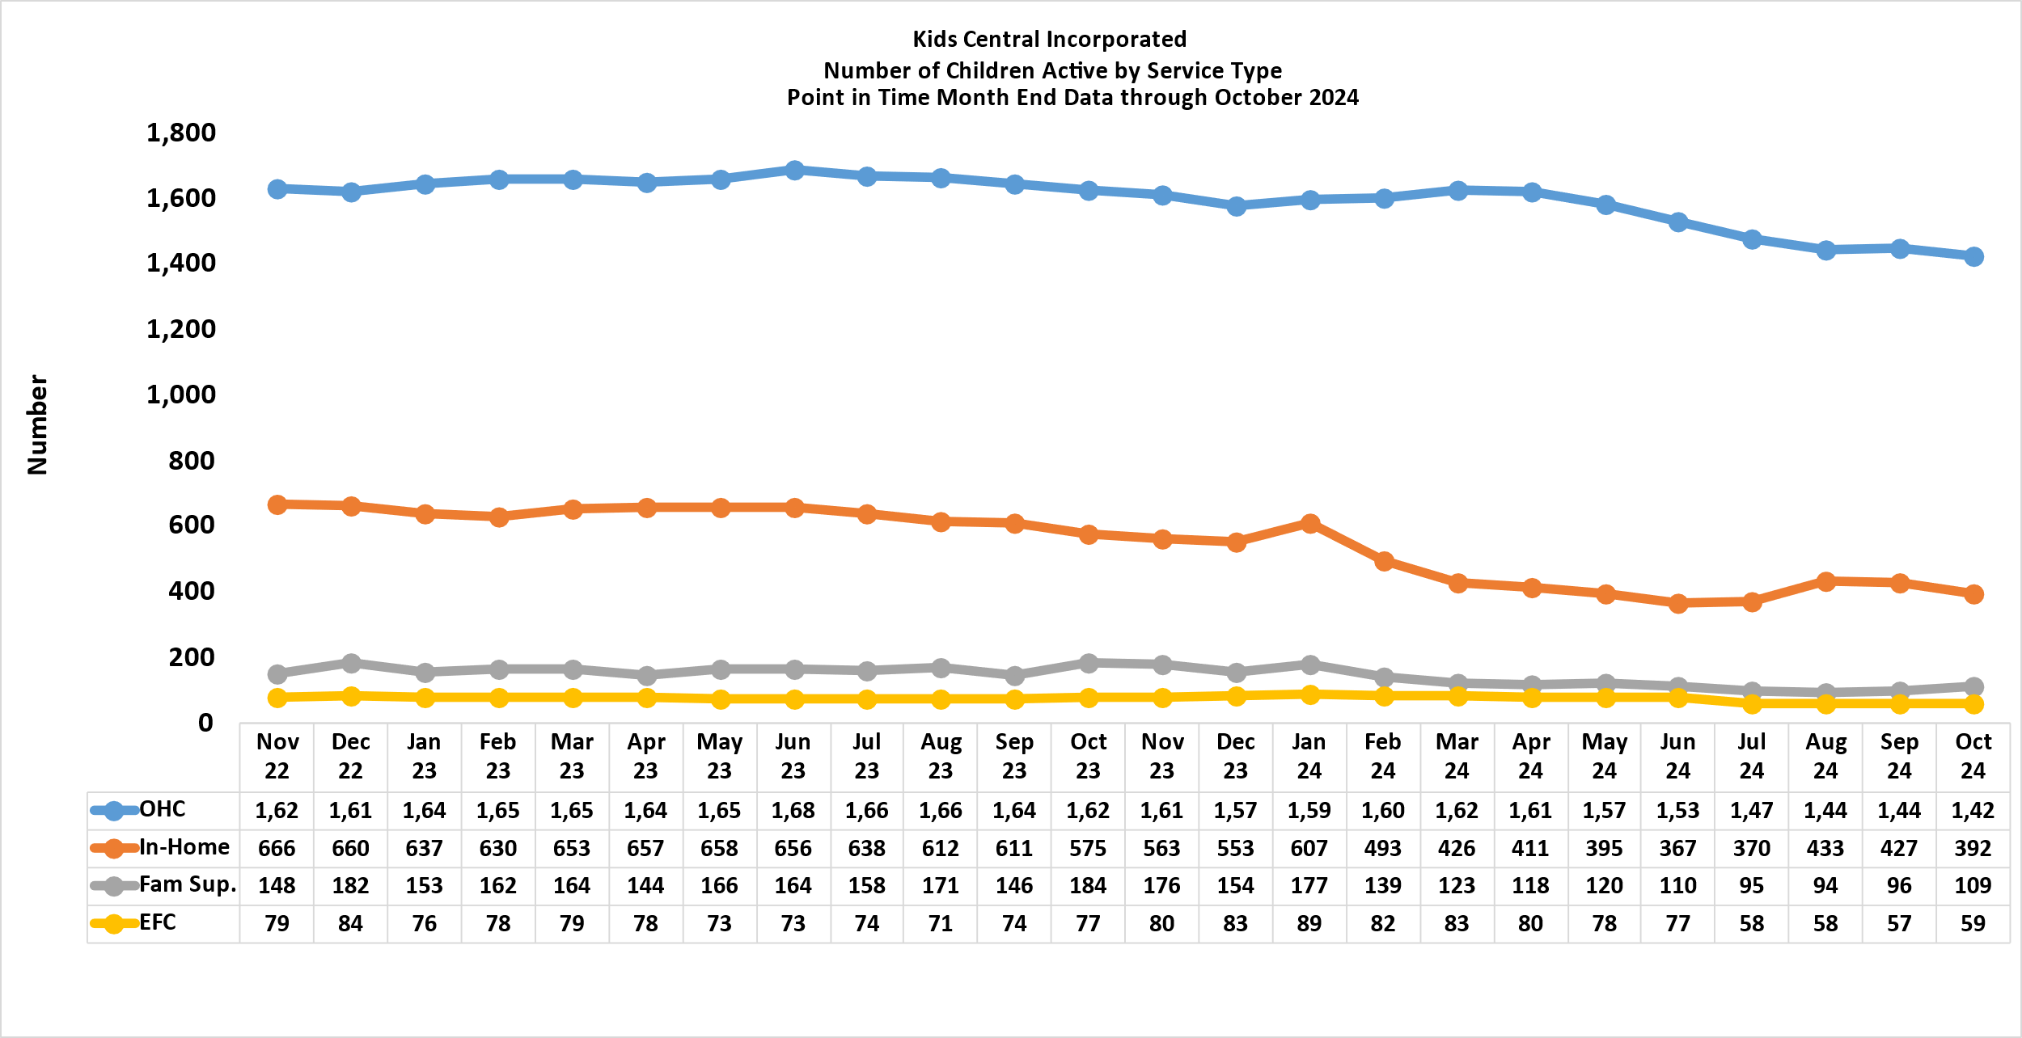

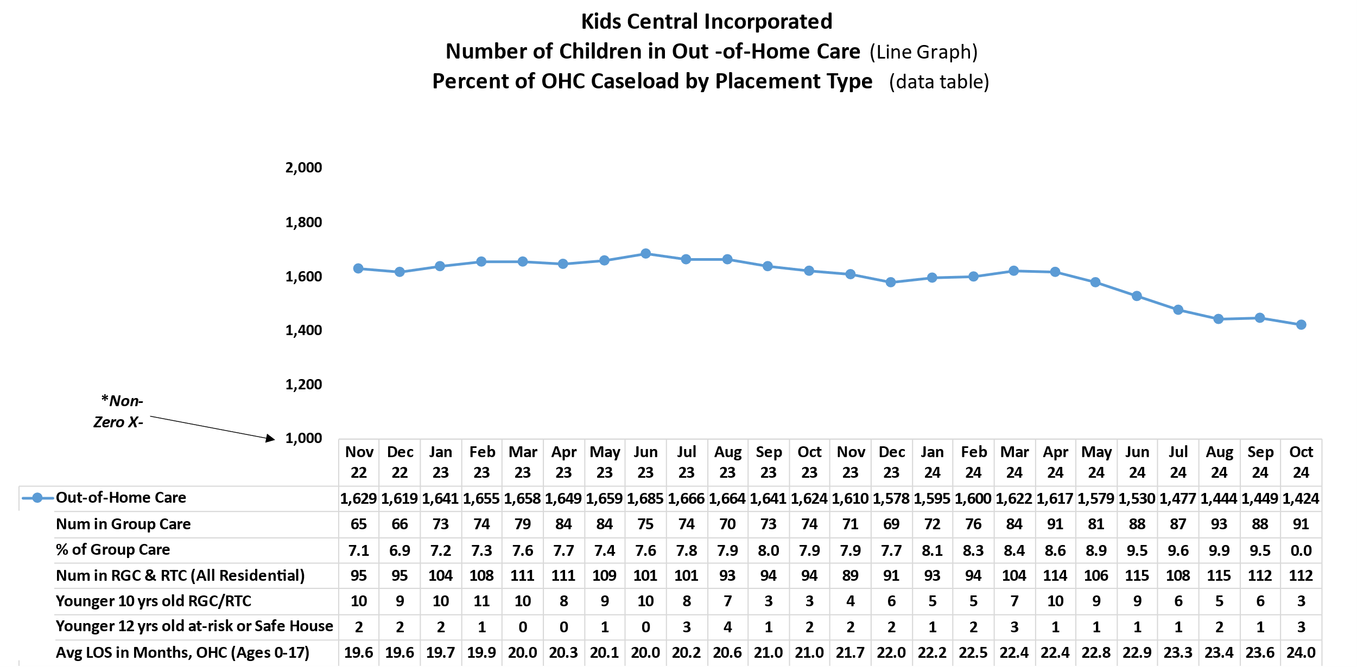
Child Caseloads – Kids Central Incorporated
Number of Children by Type of Service
Child to Caseworker Ratio
Percent of OHC Caseloads by Type of Placement

Slide 10
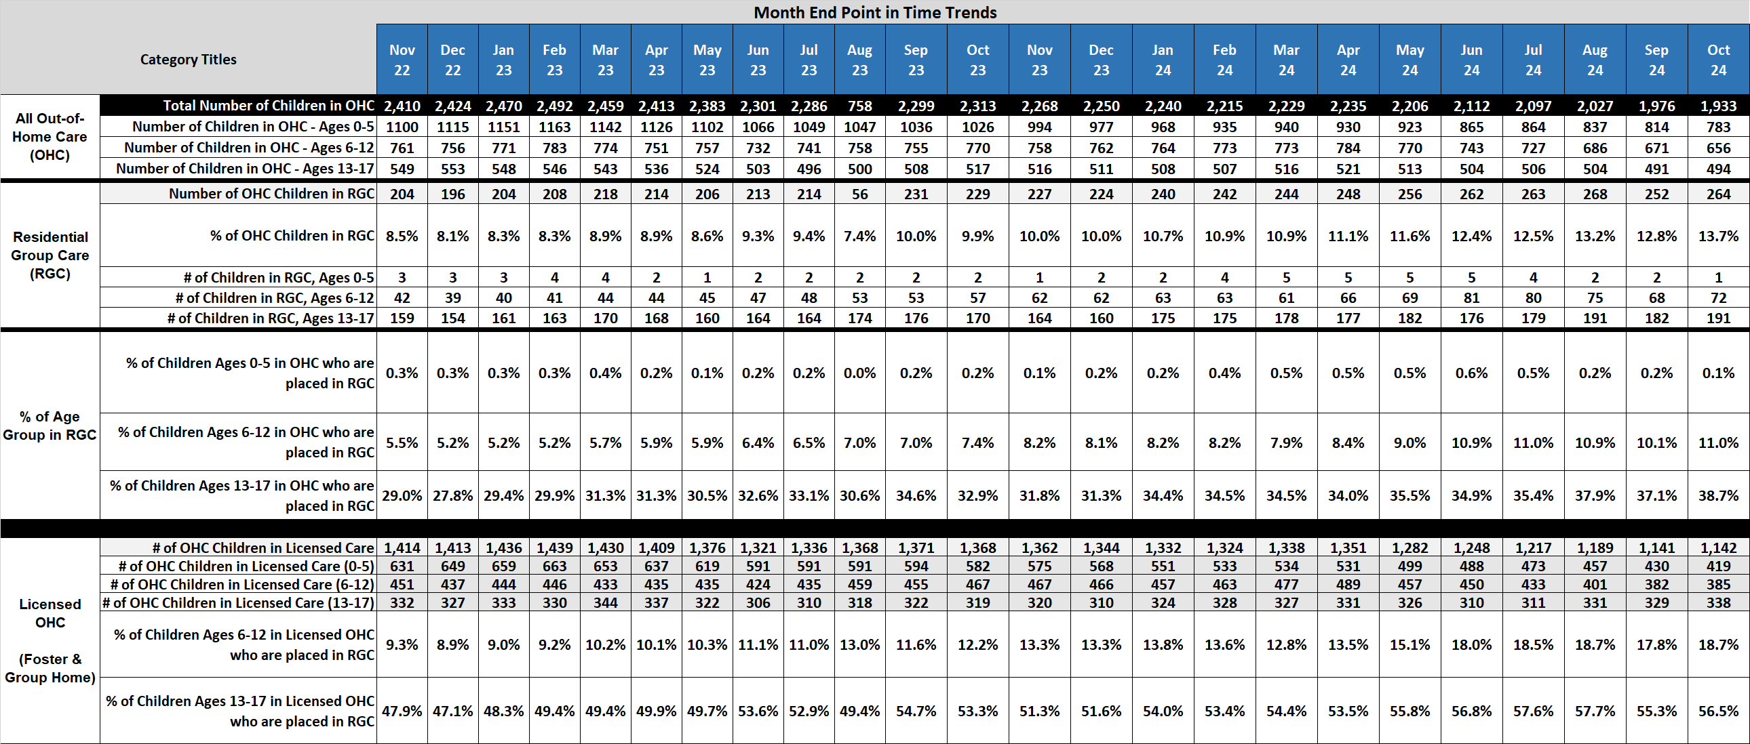
Monthly Trends of Children in Residential Group Care (RGC) & Licensed OHC by Age Range – Family Partnerships of Central Florida
Source: Month end snapshot of the OCWDRU Report "Children and Young Adults in Out-of-Home Care or Receiving In-Home Services Listing (# 1077) Criteria: - RGC is represented by both Service Types of "Residential Group Care"
- Licensed OHC are the subtotals of RGC and Foster Home totals

Slide 11
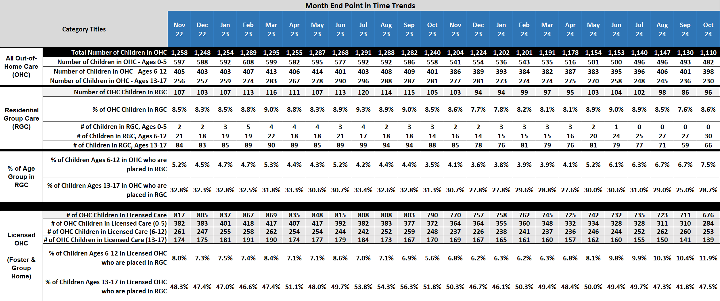
Monthly Trends of Children in Residential Group Care (RGC) & Licensed OHC by Age Range – Heartland for Children
Source: Month end snapshot of the OCWDRU Report "Children and Young Adults in Out-of-Home Care or Receiving In-Home Services Listing (# 1077) Criteria: - RGC is represented by both Service Types of "Residential Group Care"
- Licensed OHC are the subtotals of RGC and Foster Home totals

Slide 12
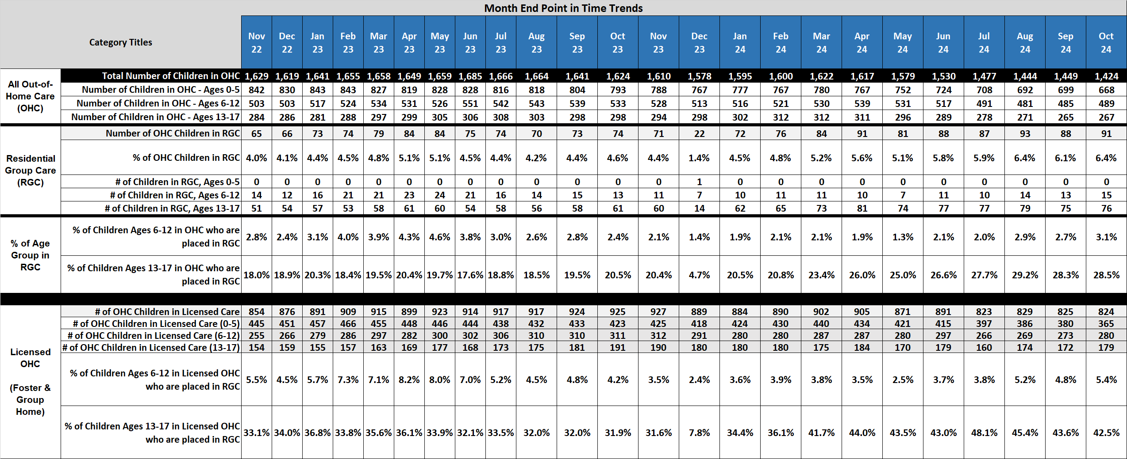
Monthly Trends of Children in Residential Group Care (RGC) & Licensed OHC by Age Range – Kids Central Incorporated
Source: Month end snapshot of the OCWDRU Report "Children and Young Adults in Out-of-Home Care or Receiving In-Home Services Listing (# 1077) Criteria: - RGC is represented by both Service Types of "Residential Group Care"
- Licensed OHC are the subtotals of RGC and Foster Home totals

Slide 13
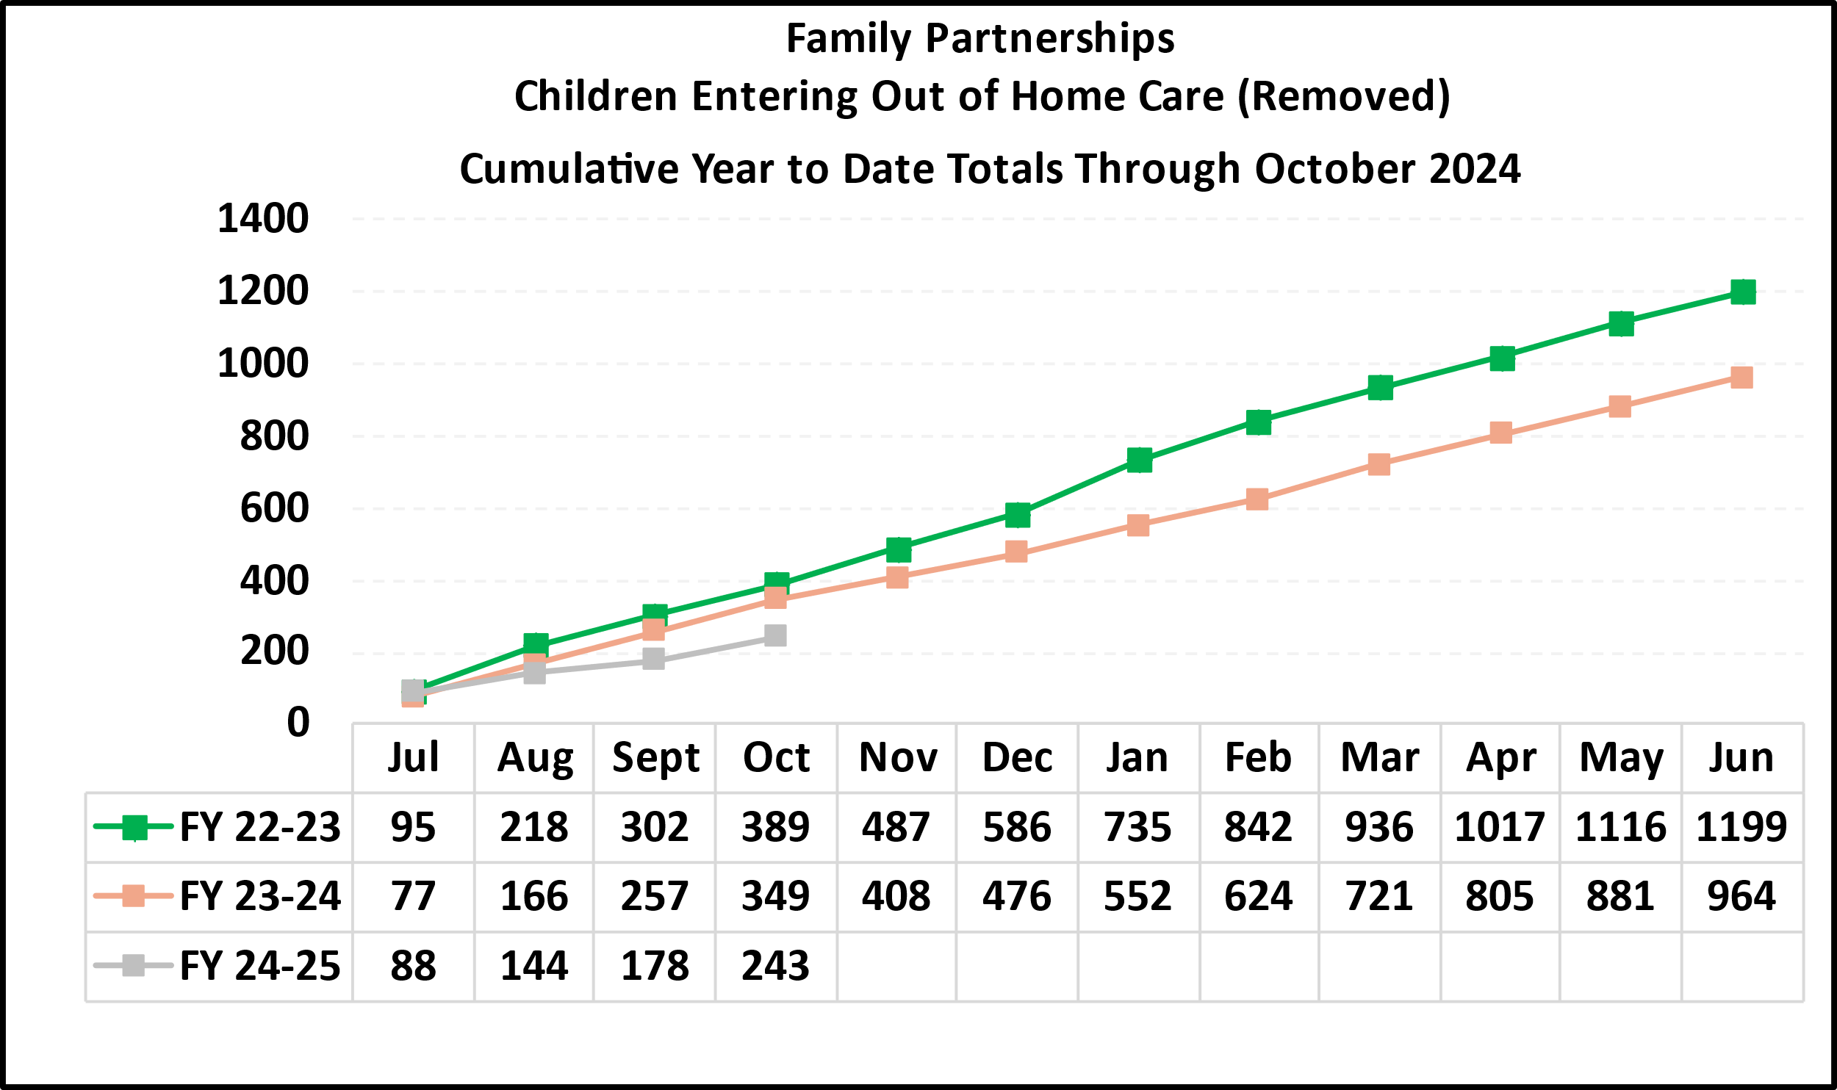
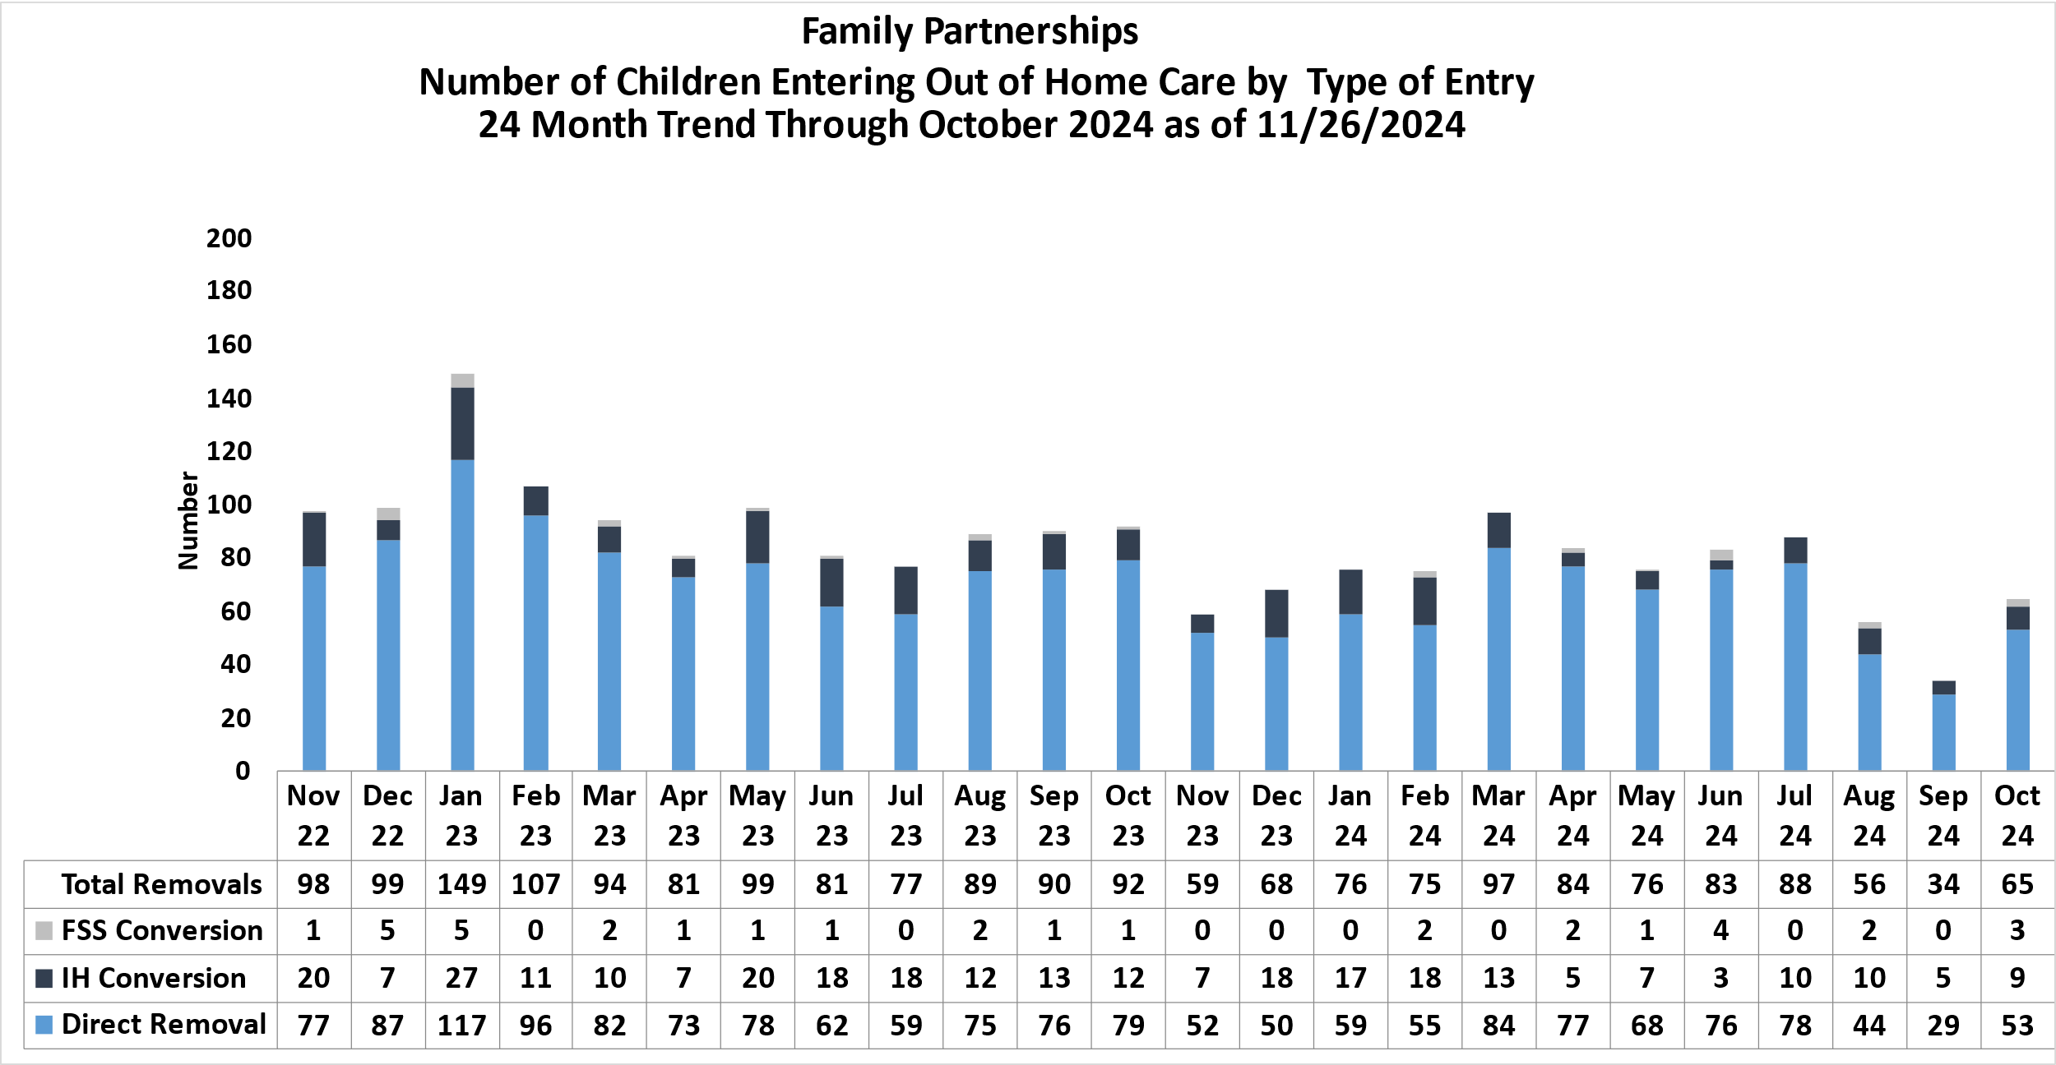
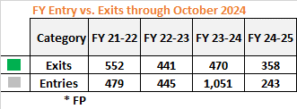
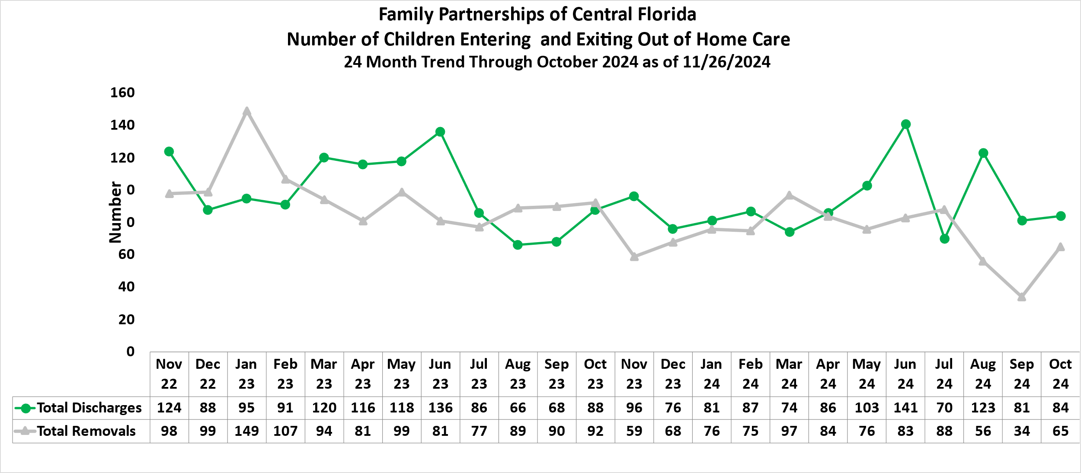
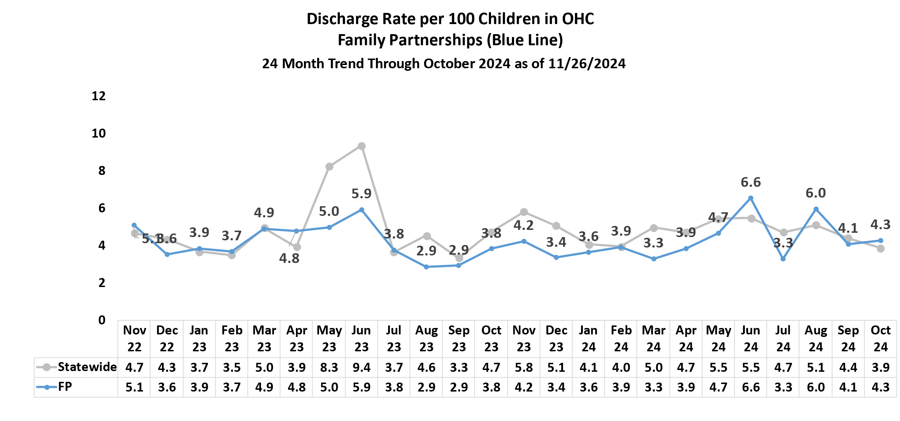
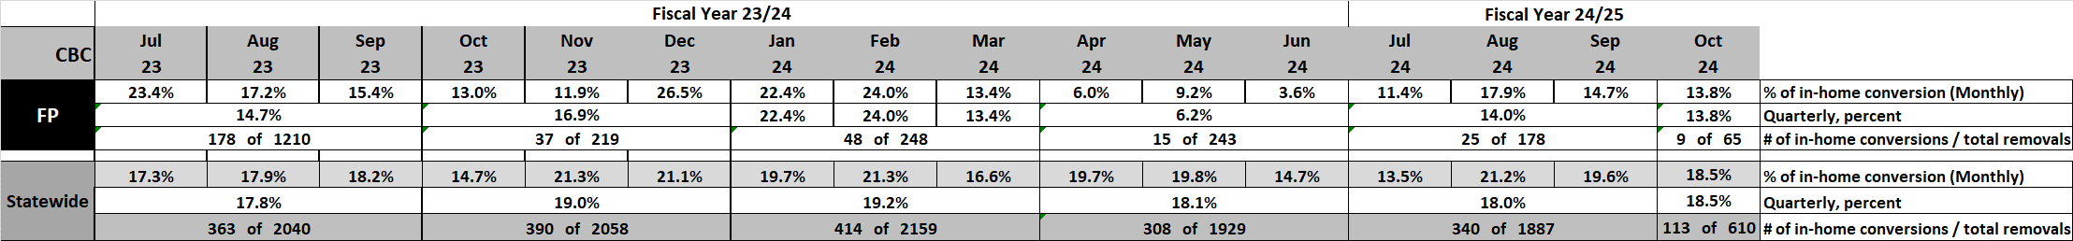
Out-of-Home Care Removal and Discharge Trends -- Family Partnerships of Central Florida
Removal Trends
Discharge Trends
Percent of Removals from an in-home case
Definitions: IH Conversion or FSS Conversion are children entering OHC care directly after a living arrangement or a FSS end date.
Source: OCWDRU FSFN report “Children Entering and Exiting Foster Care Listing - OCWDRU Report #1182” – Excluding Children aged 18 or greater.

Slide 14
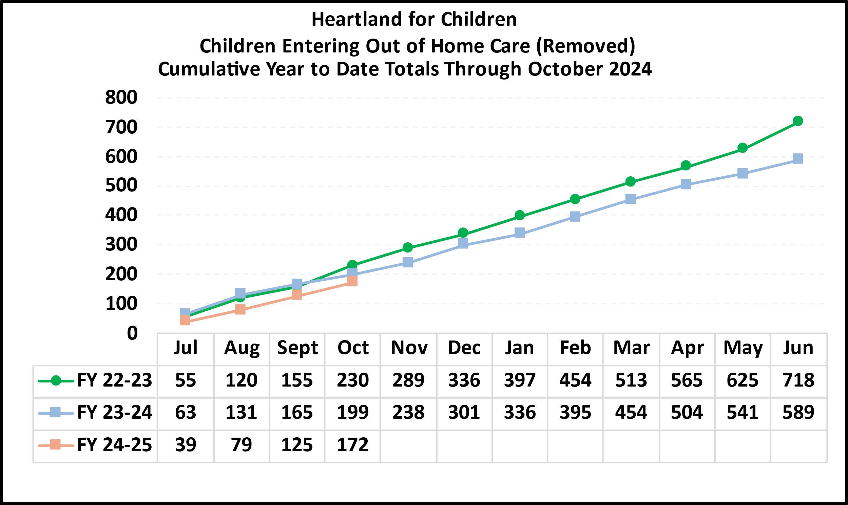
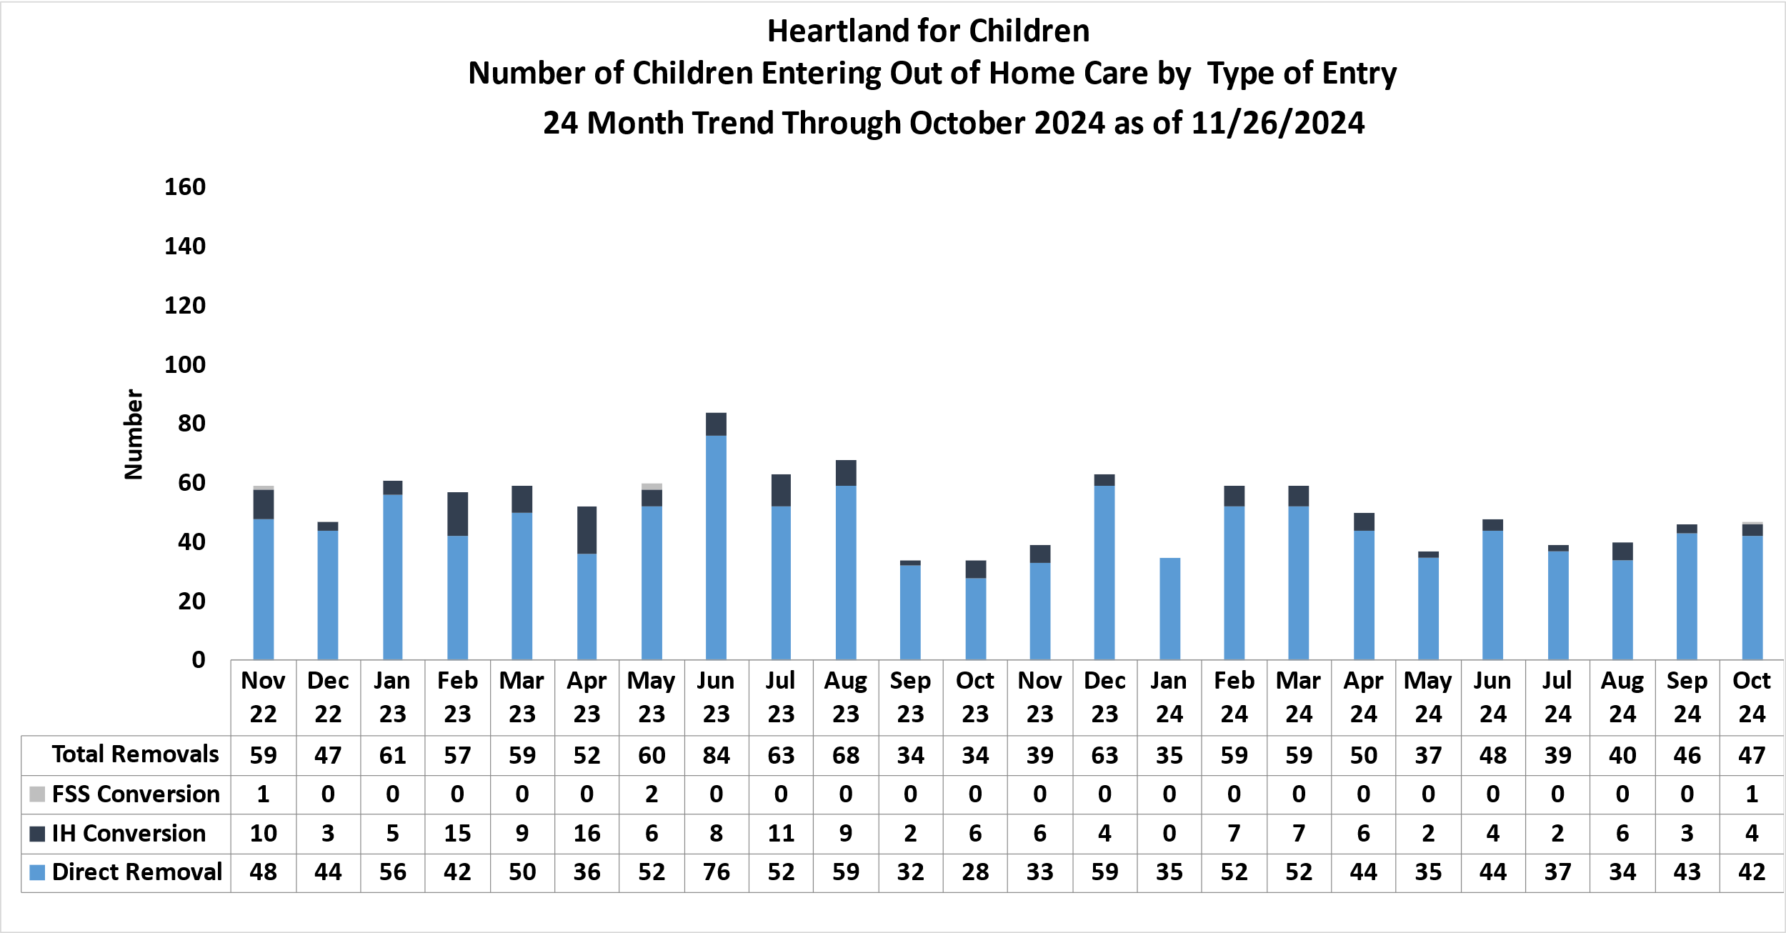
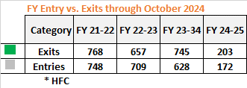
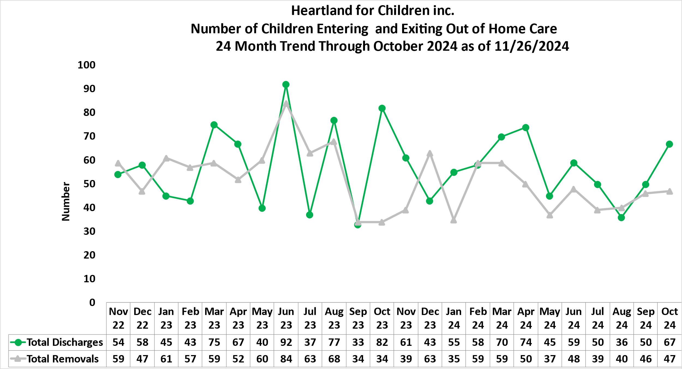
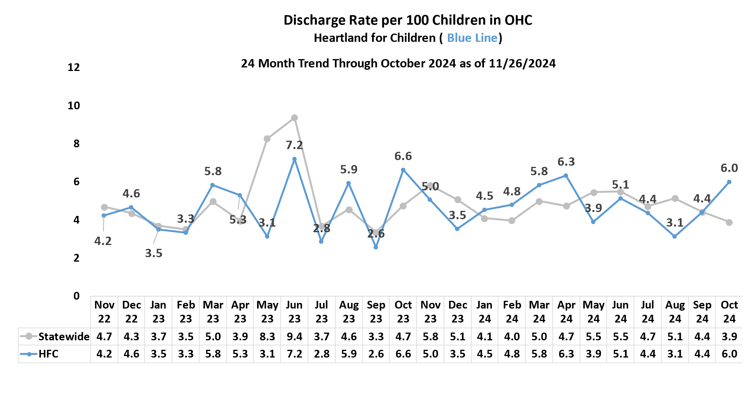

Out-of-Home Care Removal and Discharge Trends – Heartland for Children
Removal Trends
Discharge Trends
Percent of Removals from an in-home case
Definitions: IH Conversion or FSS Conversion are children entering OHC care directly after a living arrangement or a FSS end date.
Source: OCWDRU FSFN report “Children Entering and Exiting Foster Care Listing - OCWDRU Report #1182” – Excluding Children aged 18 or greater.

Slide 15
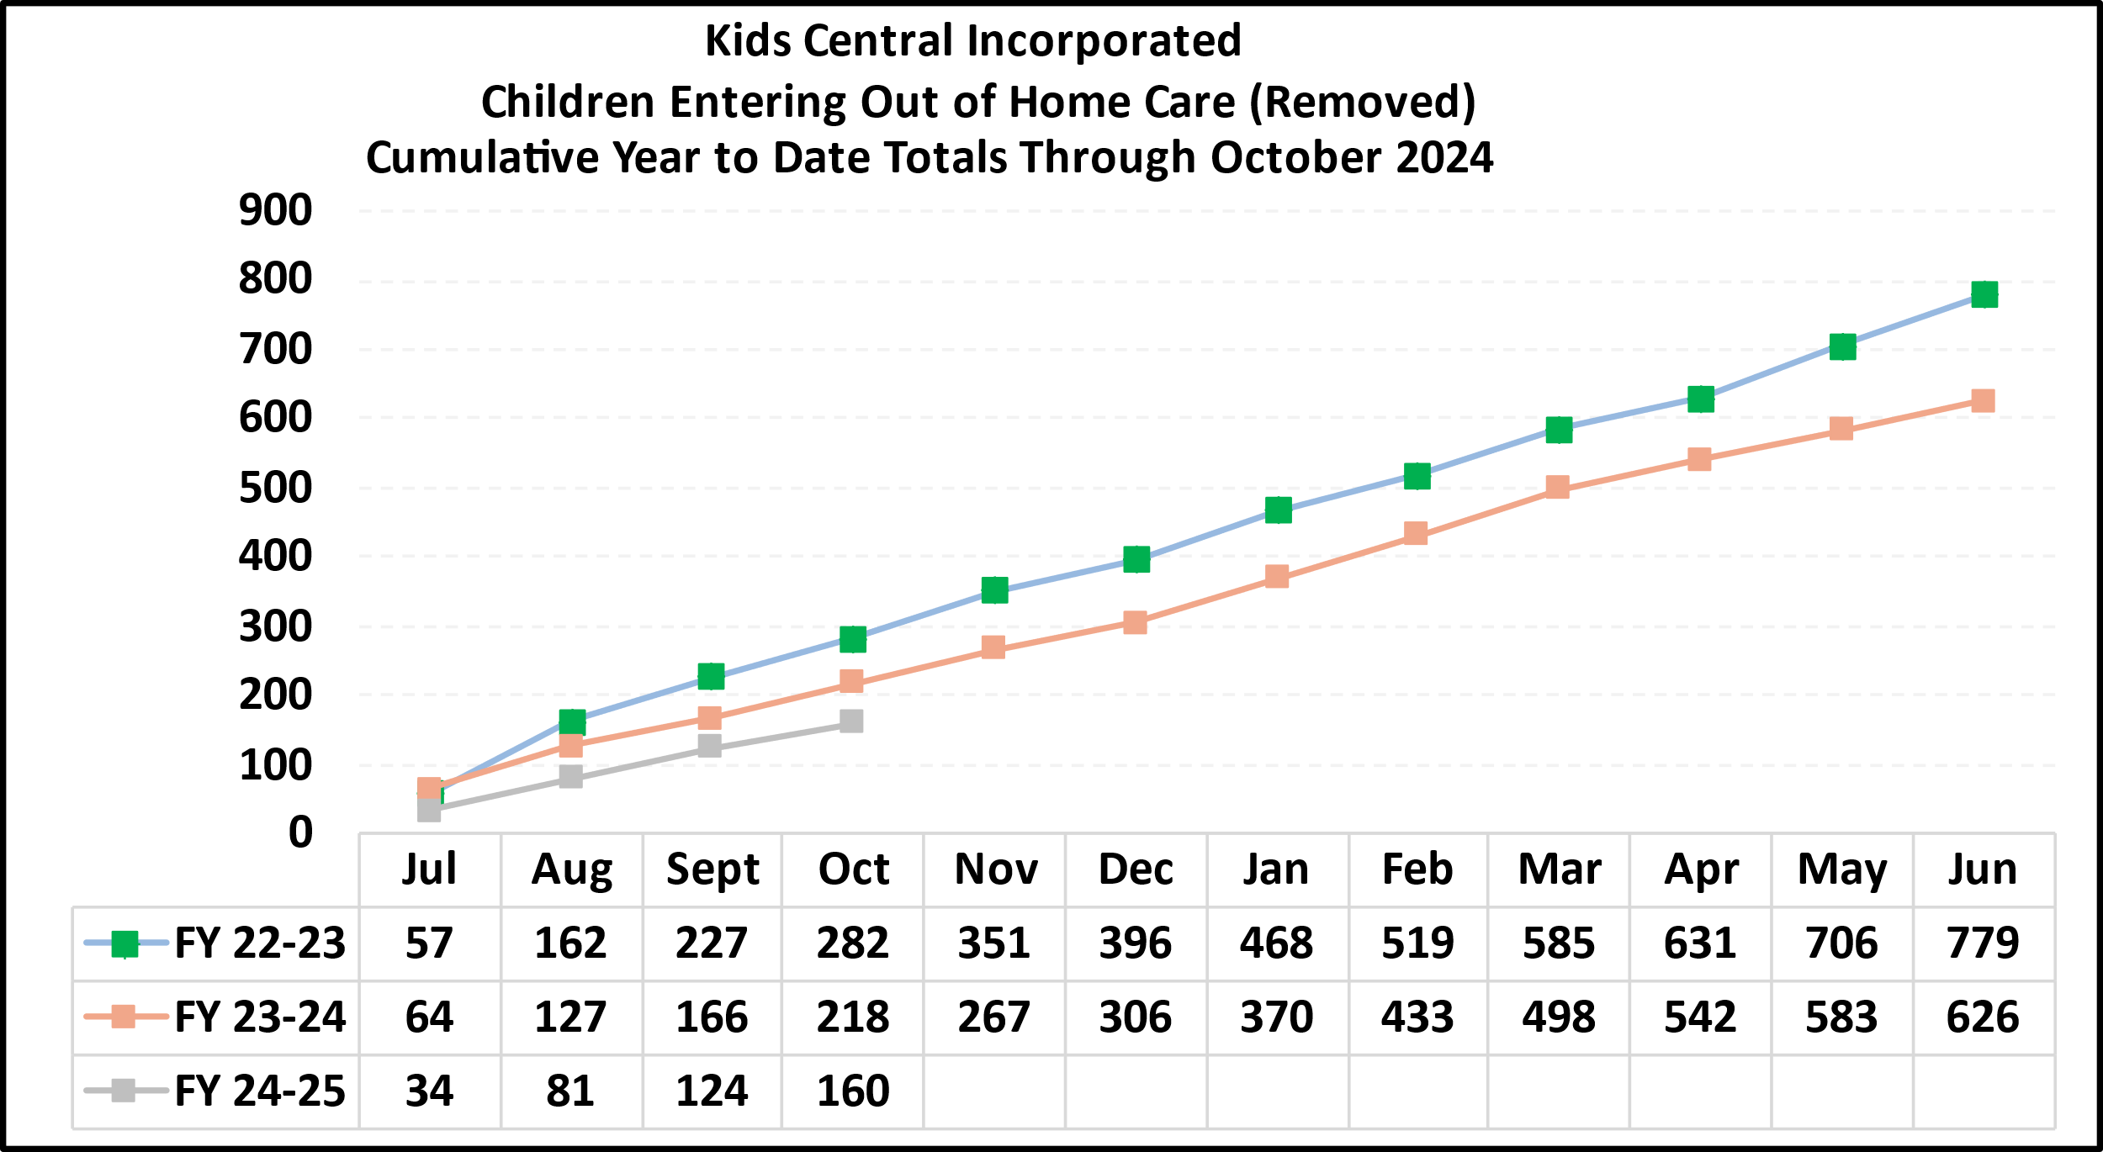
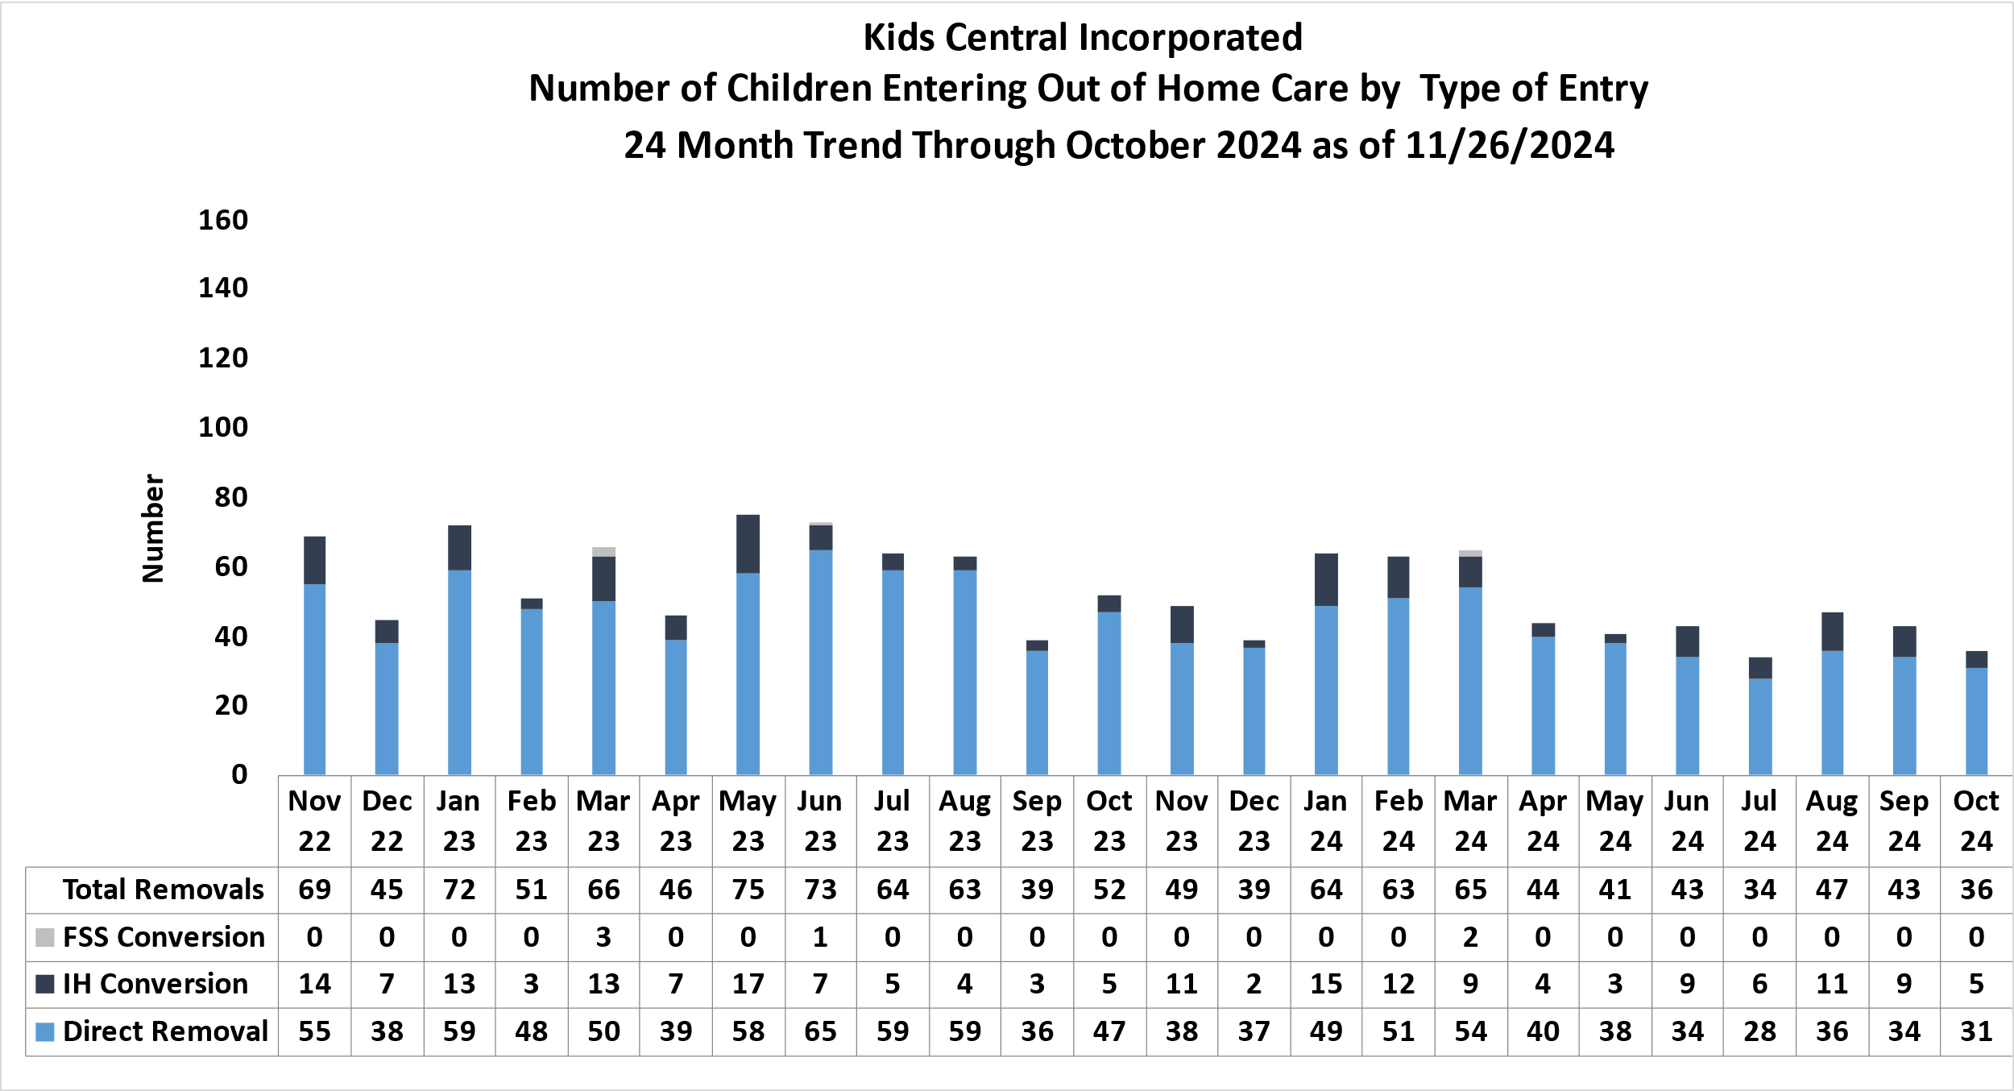
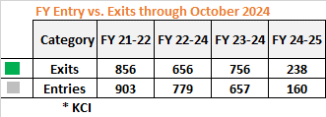
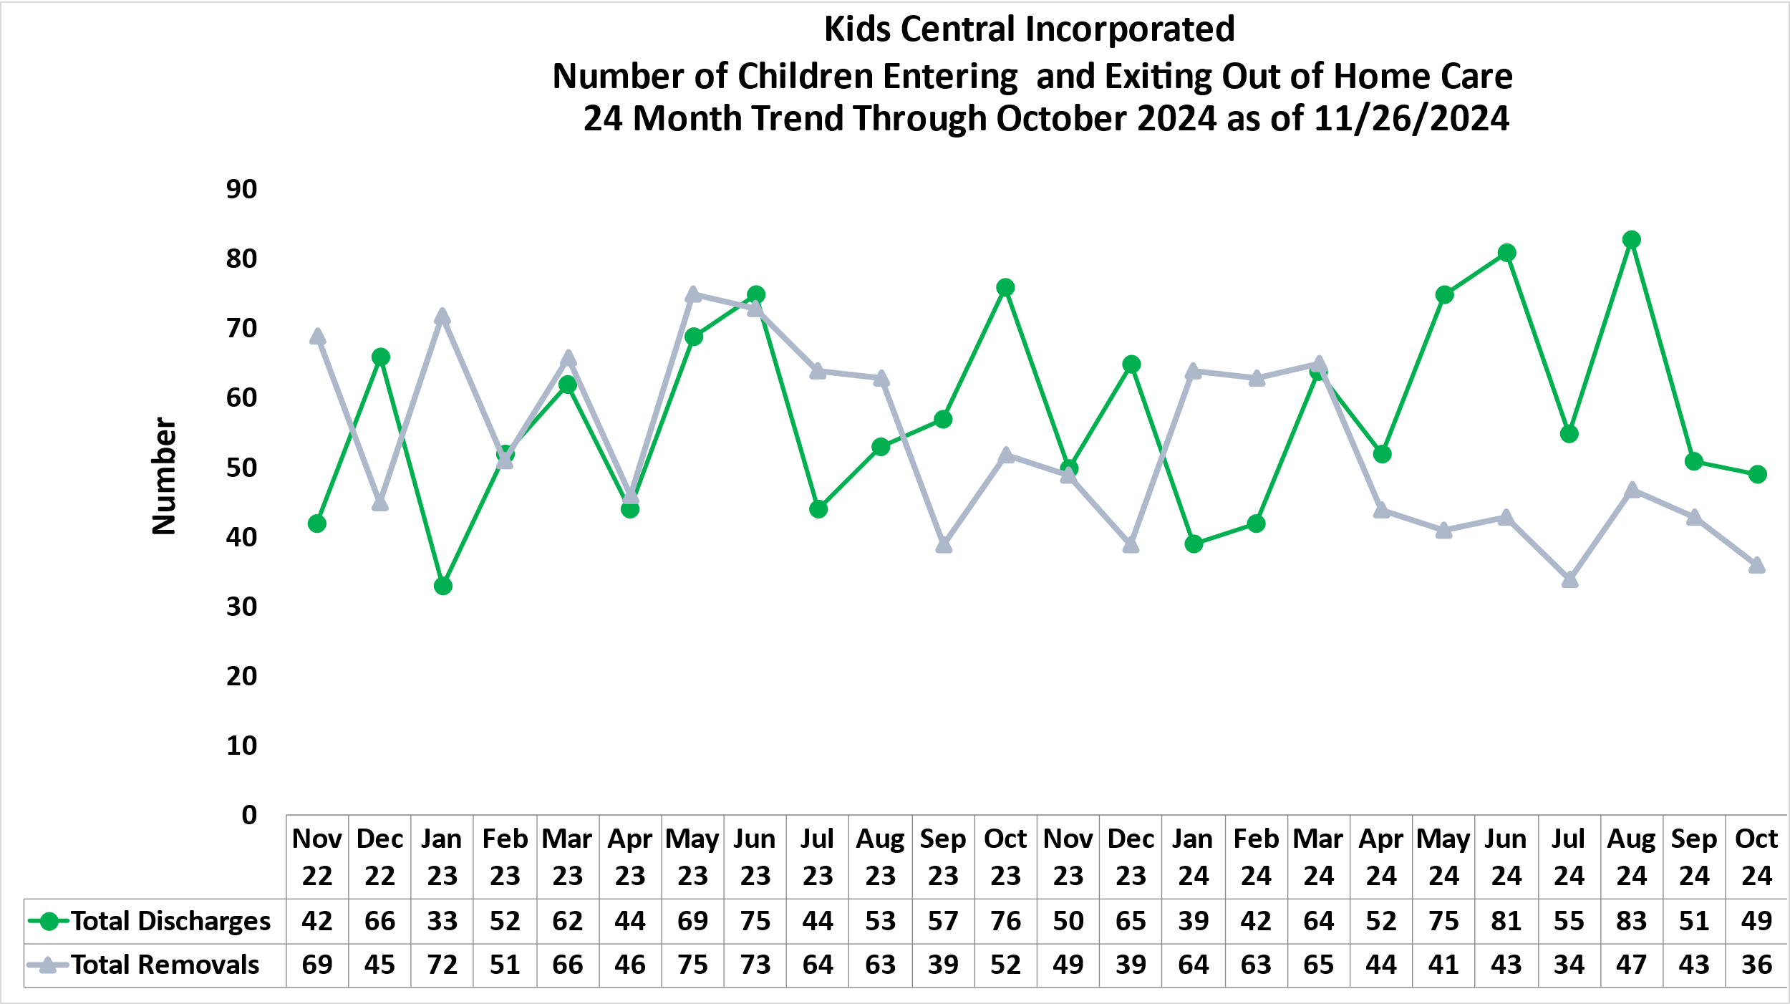
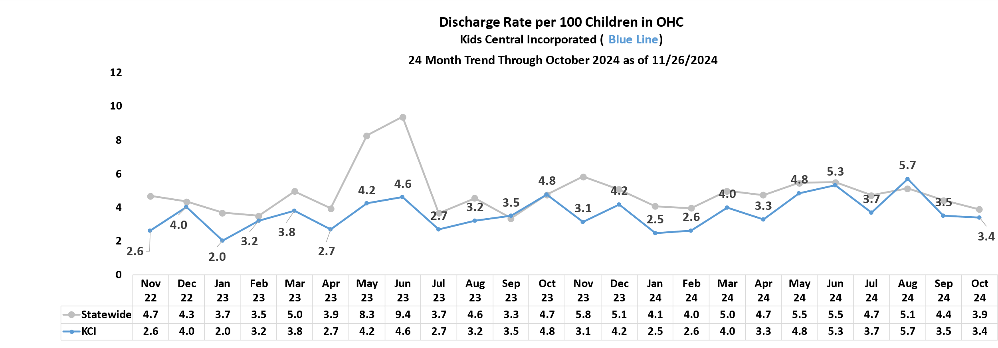
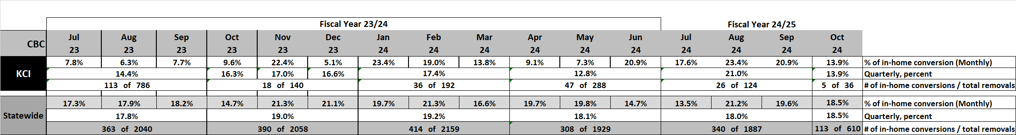
Out-of-Home Care Removal and Discharge Trends – Kids Central Incorporated
Removal Trends
Discharge Trends
Percent of Removals from an in-home case
Definitions: IH Conversion or FSS Conversion are children entering OHC care directly after a living arrangement or a FSS end date.
Source: OCWDRU FSFN report “Children Entering and Exiting Foster Care Listing - OCWDRU Report #1182” – Excluding Children aged 18 or greater.

Slide 16
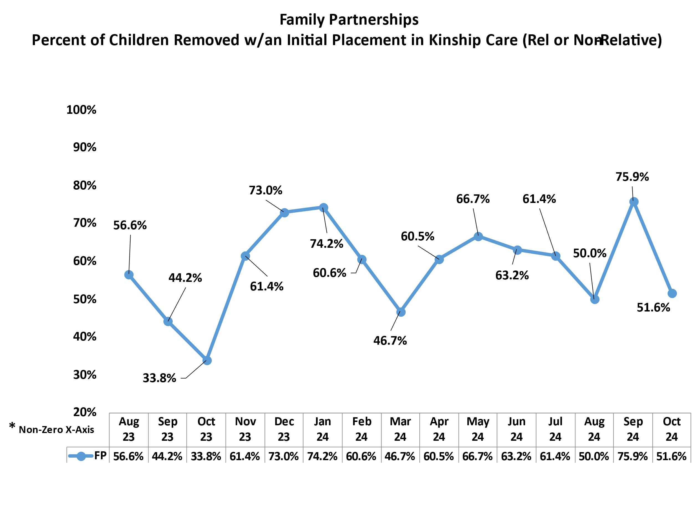
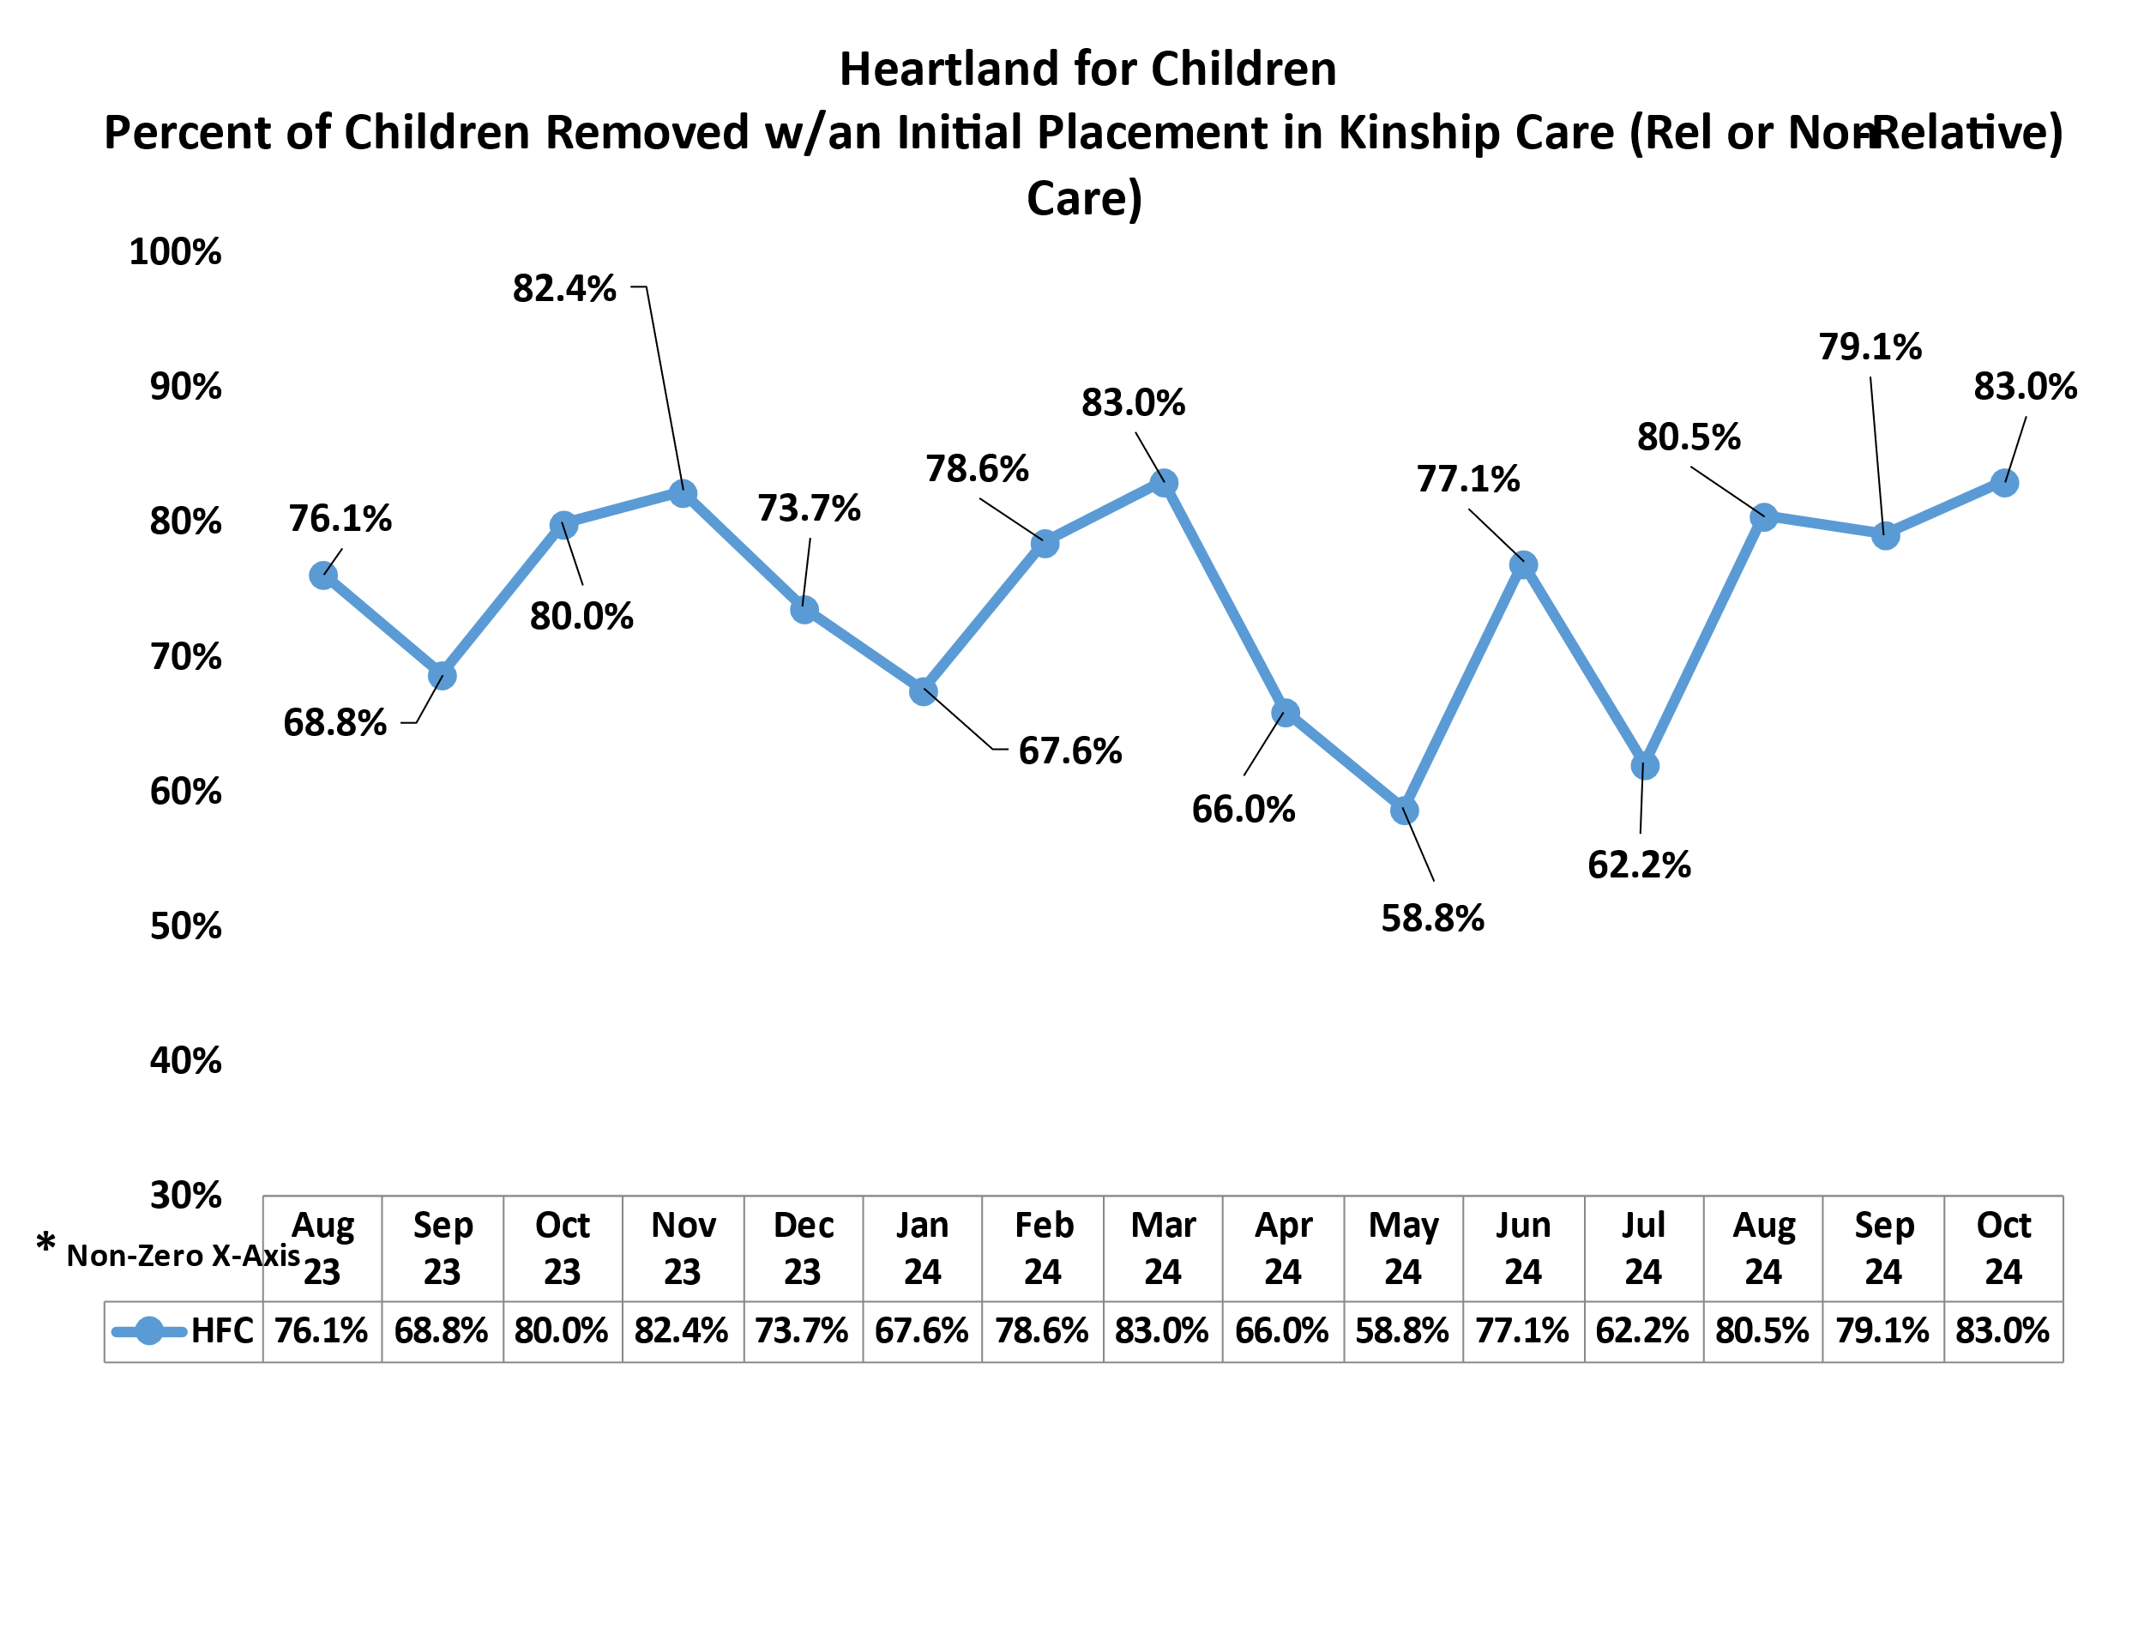
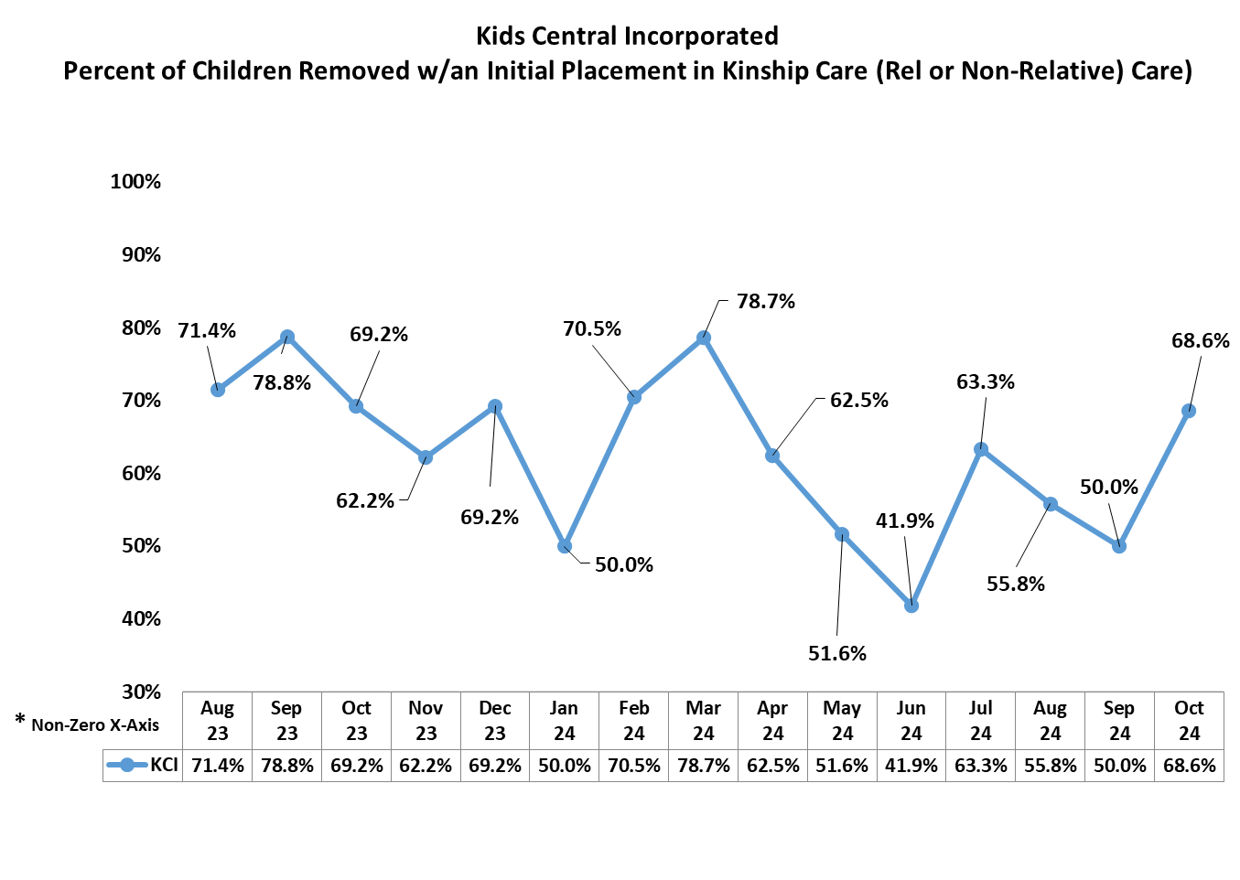
Percent of Children Removed w/an Initial OHC Placement into Kinship Care
Data Refresh Rates: Each month this report re-runs data for the last 3 months to capture removals entered after the monthly report runs.
Source: OCWDRU FSFN report “Children Whose Initial Placement is in Kinship Care On-Demand Listing - OCWDRU Report #1289” – Excluding Children aged 18 or greater.
Algorithm:
Denominator = Number of Children Removed in the month
Numerator = Children in the denominator, who have an initial out-of-home placement of relative or non-relative care.

Slide 17
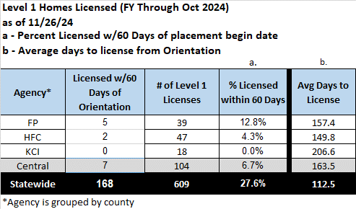
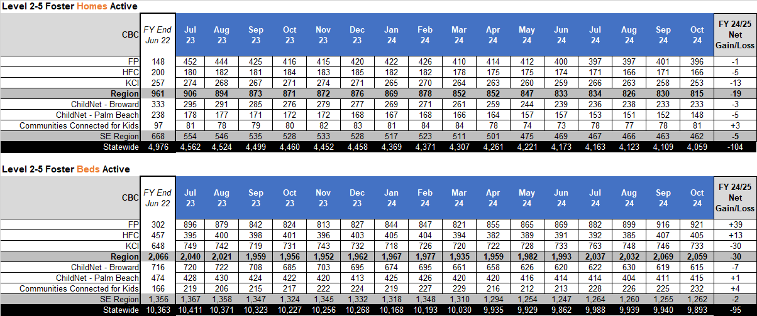
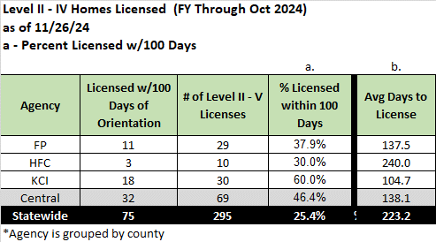
Central Region – Foster Home Outlook, Level 1-V
Net Gain or Loss… of Foster Home & Beds
Level II-V
Level 1
% Licensed w/60 Days
Level 2-5
% Licensed w/100 Days
Source: “Licensed Provider Detail Listing - OCWDRU Report #1268” & Merged with OCW manual report for amended capacity.
Source: Licensed Foster Care Providers State Fiscal Year to Date,. Report #1088
Filters:
- License Status: Active
- Excluding Level 1
- Newly licensed provider=“Yes”
Source: “Licensed Provider Detail Listing - OCWDRU Report #1268” & Merged report 1077 for children in their home.

Slide 18
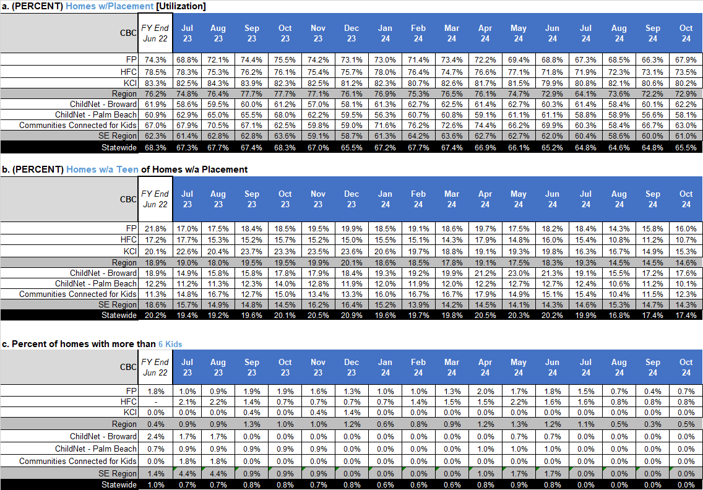
Central Region – Foster Home Outlook, Level 1-V
Capacity Measures
a. Home Utilized
b. Home Utilized w/ a Teen Placed
c. Homes w/more than 6 DCF Children
Source: “Licensed Provider Detail Listing - OCWDRU Report #1268” & Merged report 1077 for children in their home.

Slide 19
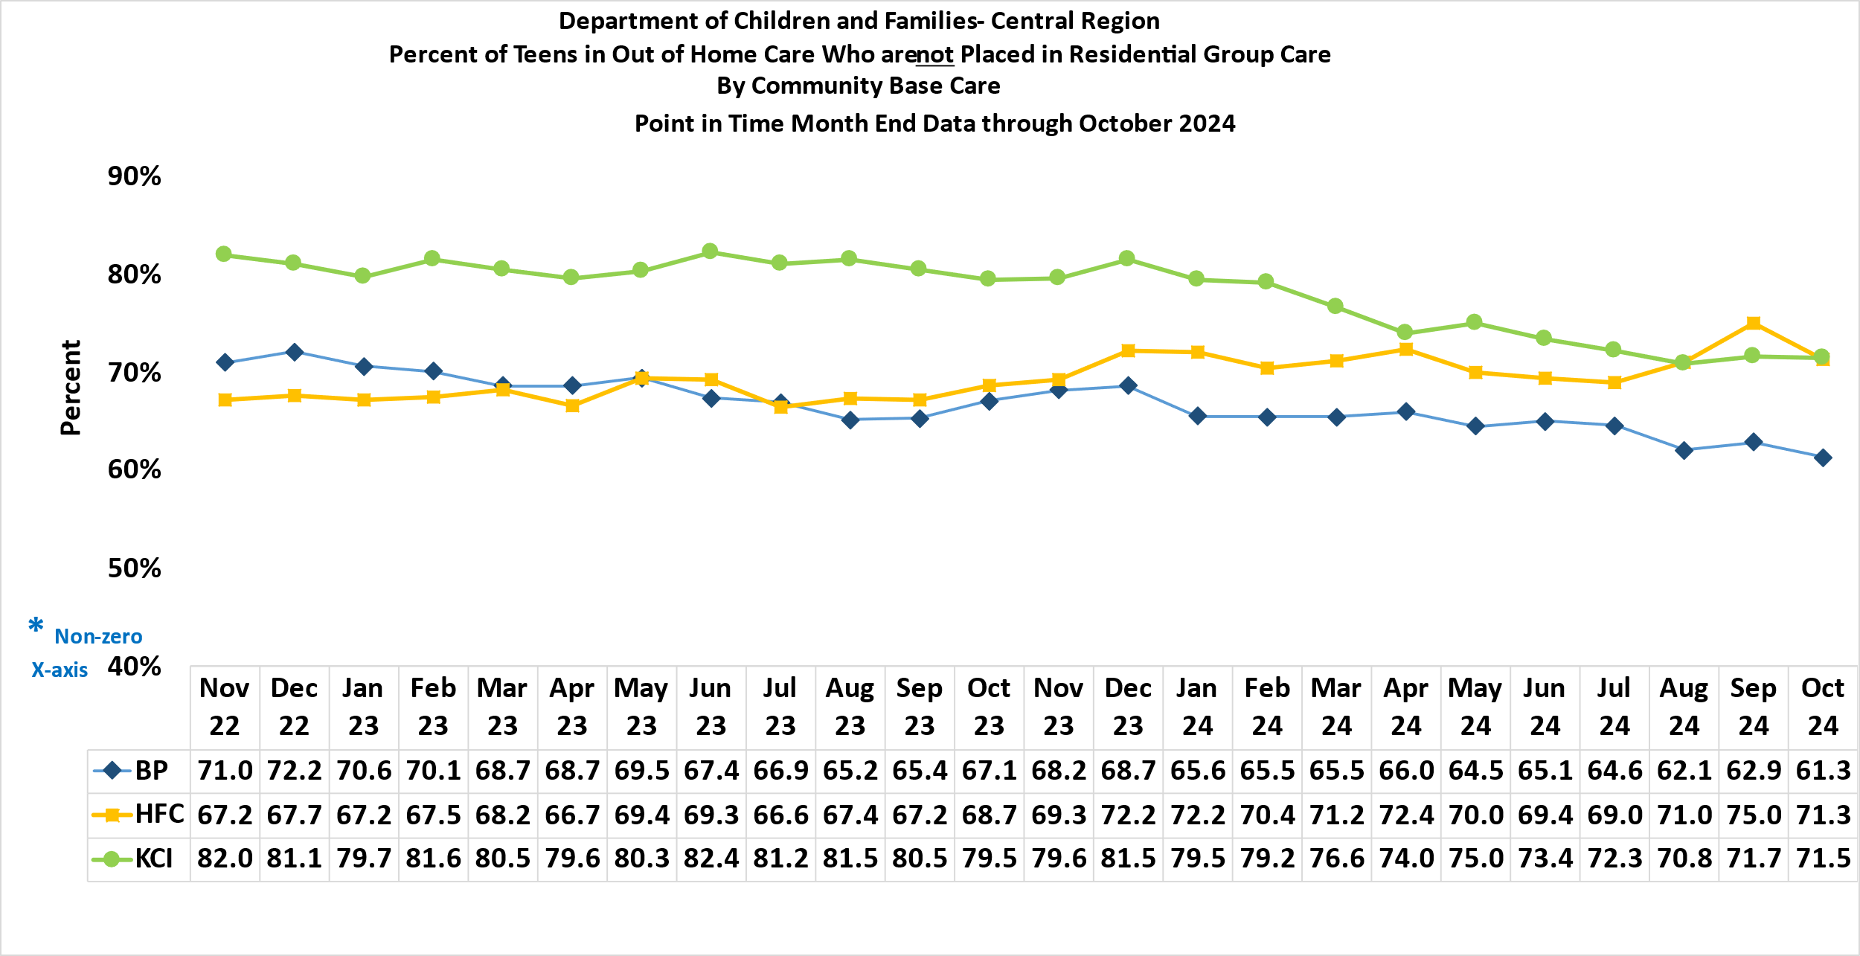
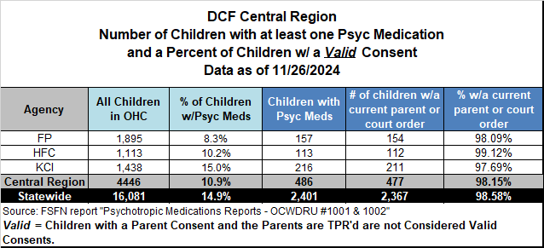
Other Out-of-Home Trends
Psychotropic Medication
Teens in a family setting
(not in RGC)
Algorithm: Number of teens (aged 13-17) not placed in RGC divided by total number of teens in OHC.
Source report: OCWDRU report 1077 as of the end of each month.

Slide 20
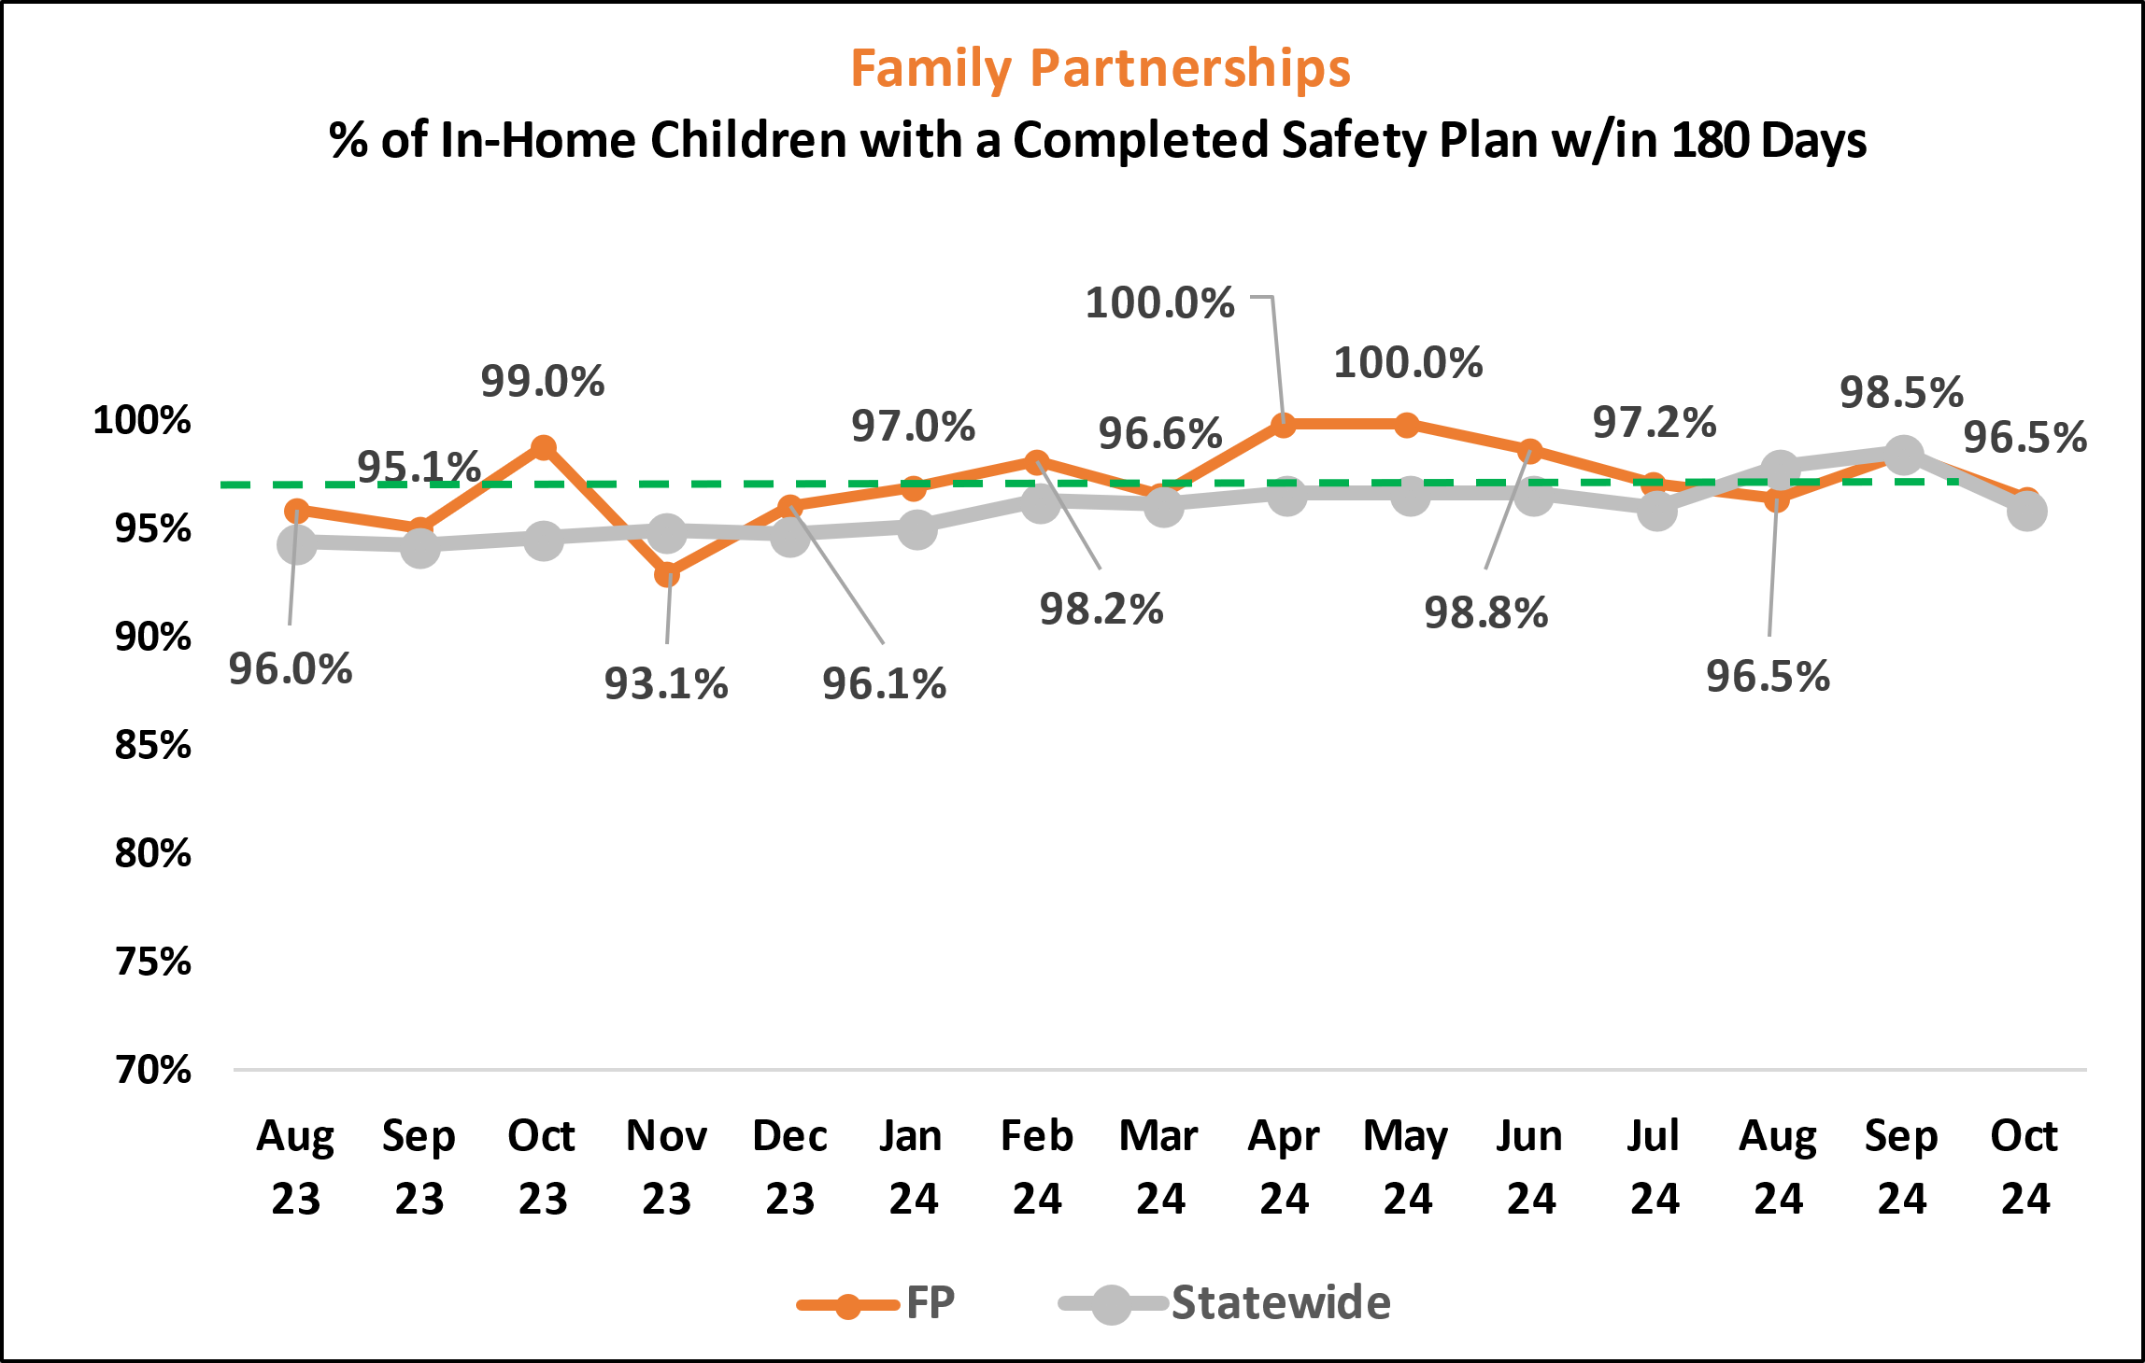
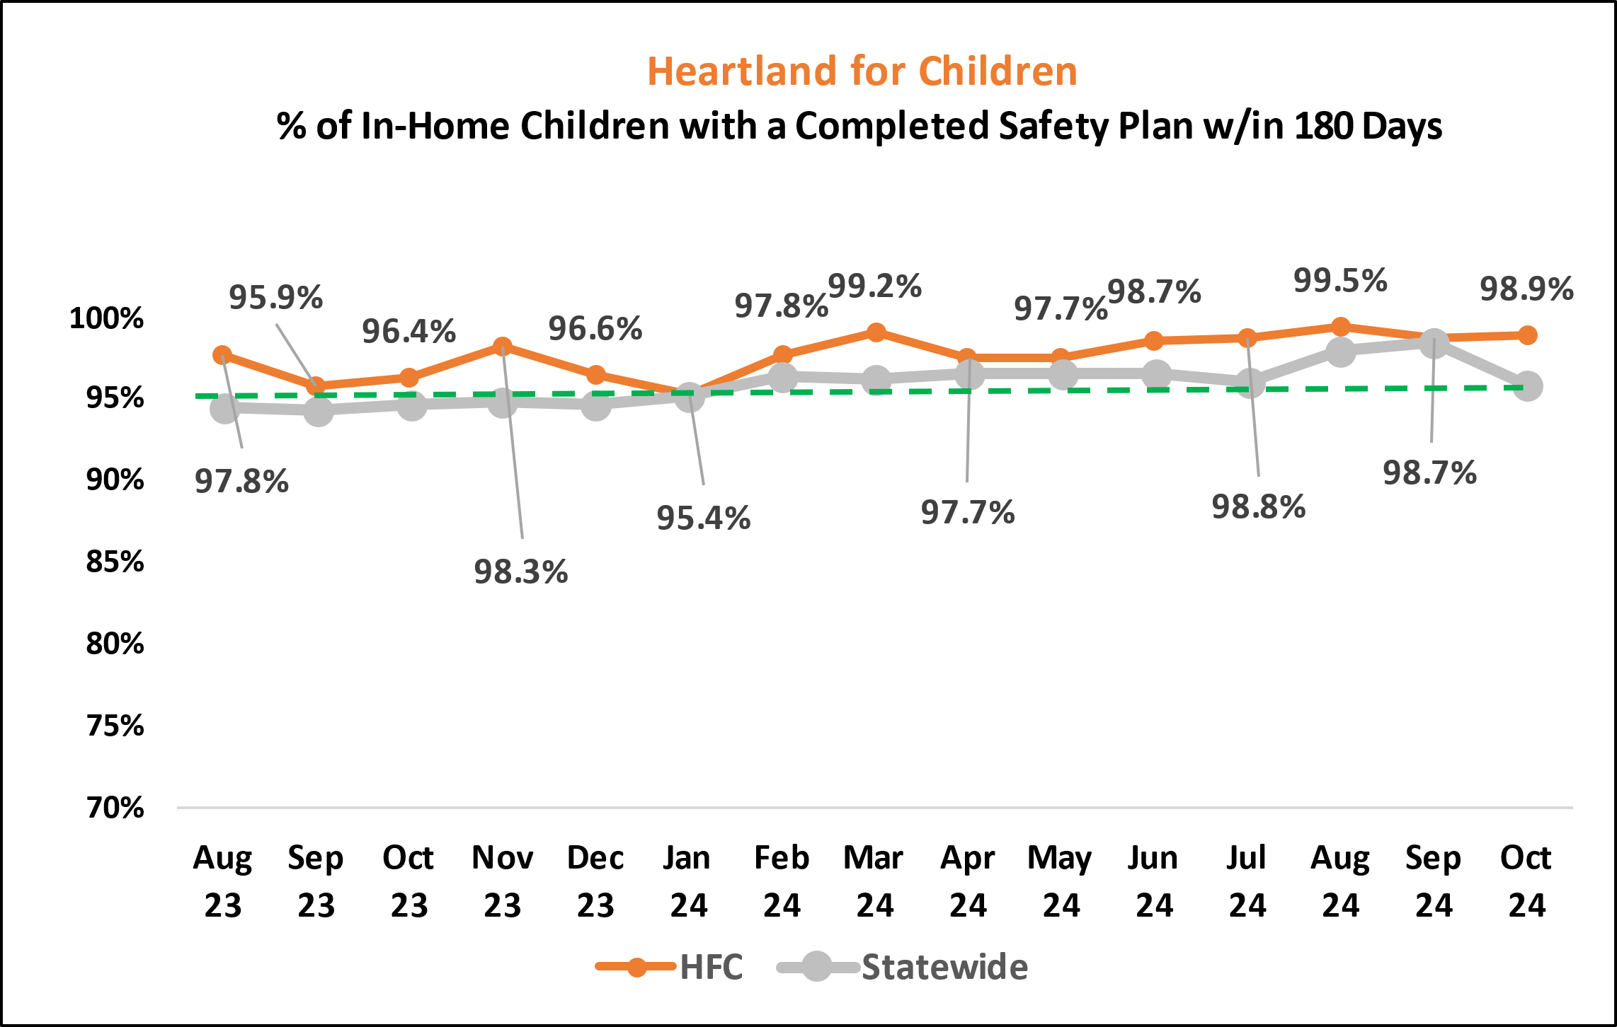
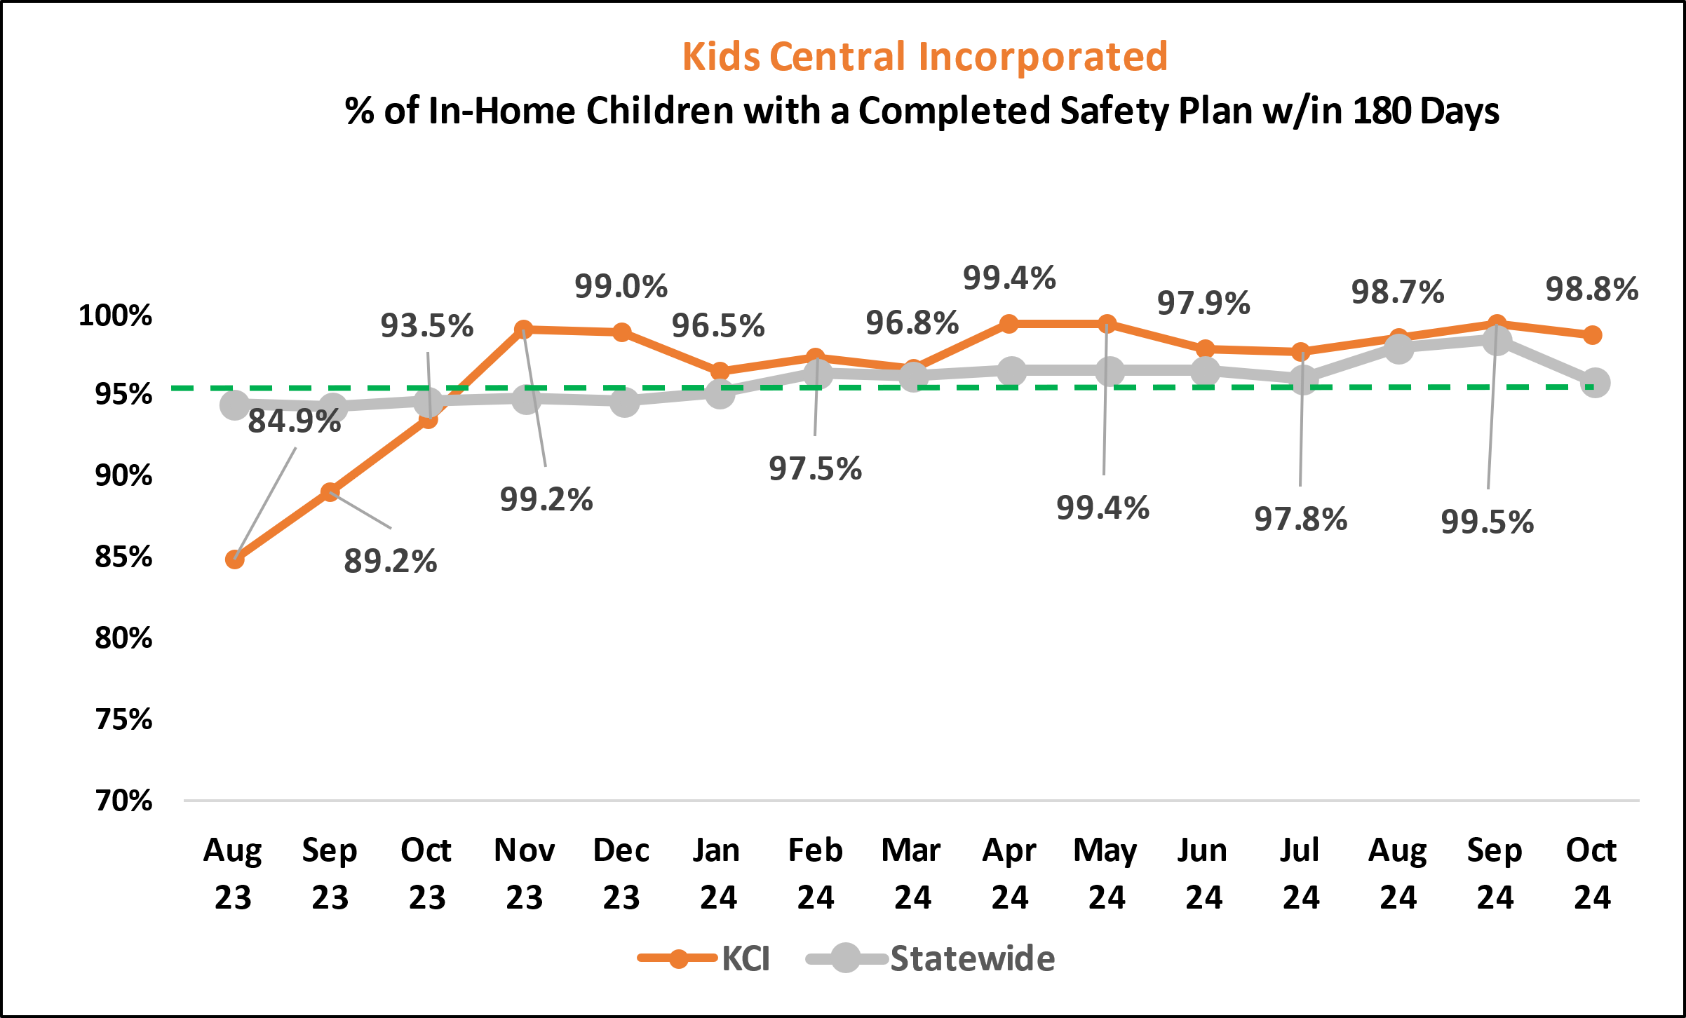
Percent of Active In-Home Children with a Completed Safety Plan within 180 days
Source: OCWDRU FSFN report “Case Management Safety Management Listing - OCWDRU Report #1301.
Exclusions: any unit not assigned to a CBC & excluding ICPC case types

Slide 21
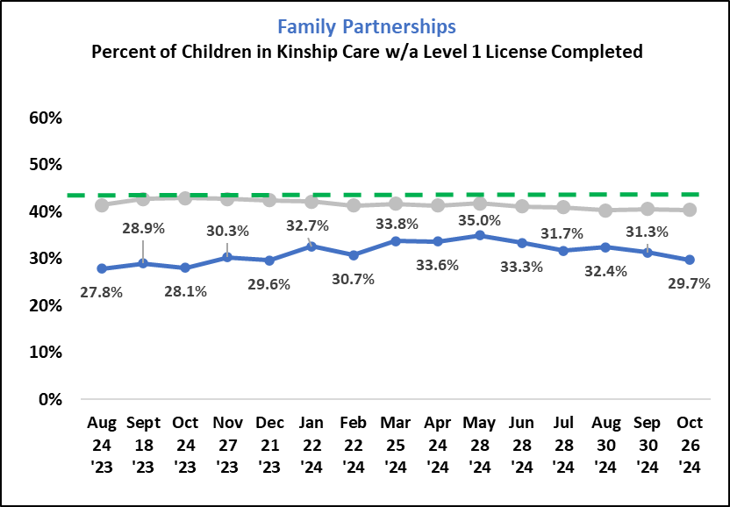
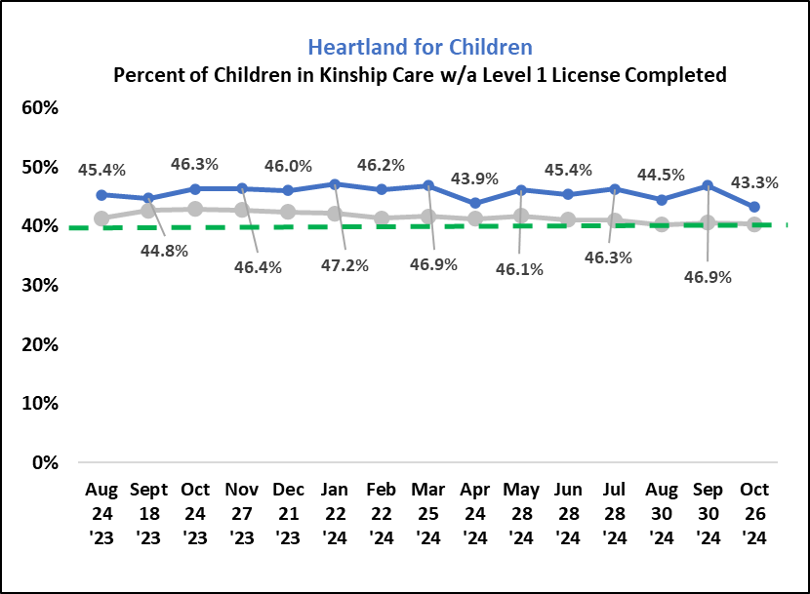
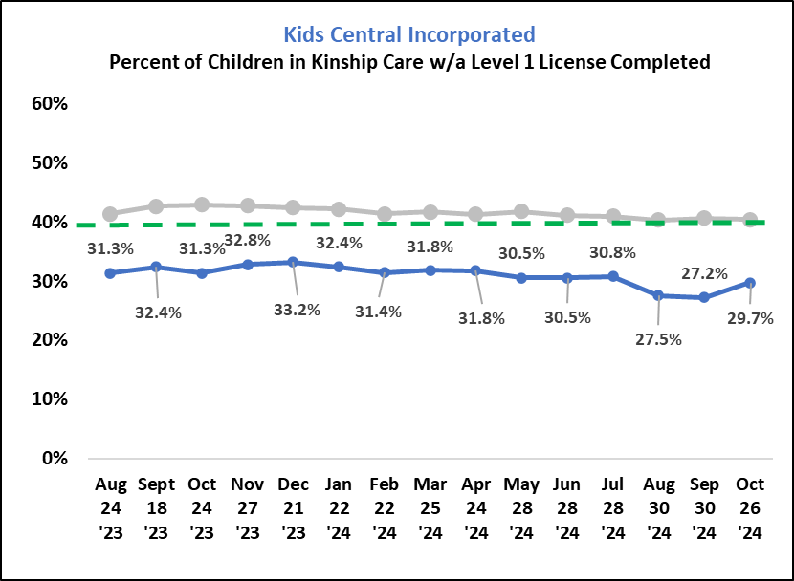
Percent of Children in Kinship Care with a Level 1 License Completed
Source: FSFN report “Children Placed with Licensed or Pending Licensed Relatives or Non-Relatives On-Demand Summary– OCWDRU Report #1312”

Slide 22
Snapshot of Child Active in Licensed OHC, Placed Outside of Removal County, Circuit, or Region
Statewide by region and circuit as of 10/31/2024
Source: FSFN report “Children in Licensed Out-of-Home Care Placed Outside of Removal County/Circuit/Region - OCWDRU Report #1192”

